Slide 2
National actions to support WASH FIT & links with health
WASH FIT introductory module
Add date & location
Notes:
Introduce yourself if you have not already, and make sure you insert the date and location to the slide before you start
NOTE FOR TRAINER:
This module was updated in February 2022. A number of slides related to COVID-19 have been included. Trainers are advised to check the WHO website for the latest technical guidance which may change as new evidence emerges. https://www.who.int/emergencies/diseases/novel-coronavirus-2019/technical-guidance

Slide 3

Learning objectives
By the end of this session, you should:
Understand the latest global data and monitoring mechanisms for WASH in HCF
Describe how WASH in HCF is addressed in quality, maternal and child health, IPC and antimicrobial resistance guidance and tools and how to engage with health partners
Explain elements of the 2019 World Health Assembly Resolution on WASH in HCF, how progress is being tracked and efforts to strengthen accountability
Understand the global targets and metrics of success for advancing WASH in HCF
Understand the latest WHO recommendations on WASH in HCF in the context on COVID-19
Know where to get more information from WHO and UNICEF on WASH in HCF
Icons to look out for
Group
work
Notes:
READ SLIDE

Slide 4
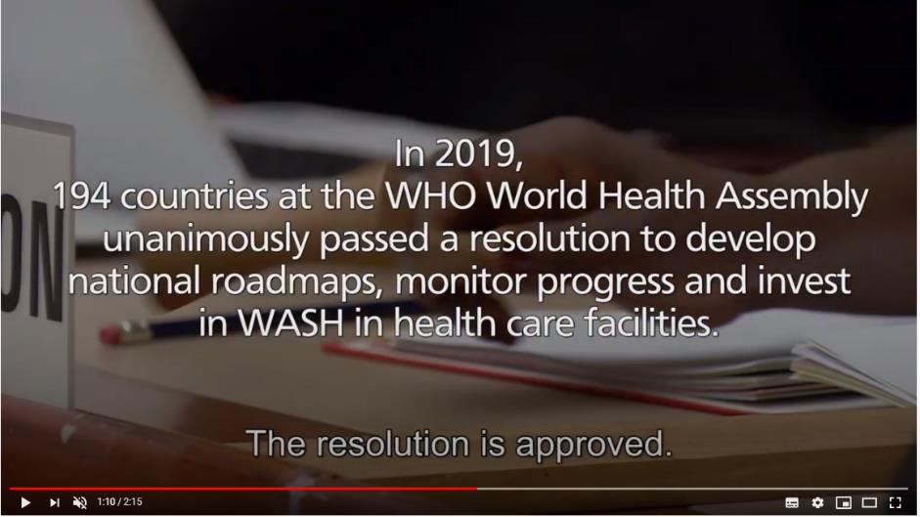
“The Resolution is Approved ”
August 2019
https://www.youtube.com/watch?v=Su53NTLFkdA&feature=youtu.be
Notes:
SAY:
This short video sets the scene for the global work on WASH in health care facilities
NOTE FOR TRAINER:
Play the video by copy pasting the URL into a web browser
If a video cannot be shown during the presentation, (e.g. due to poor internet connection for virtual audiences), this may be skipped and the link sent to participants to watch afterwards.

Slide 5
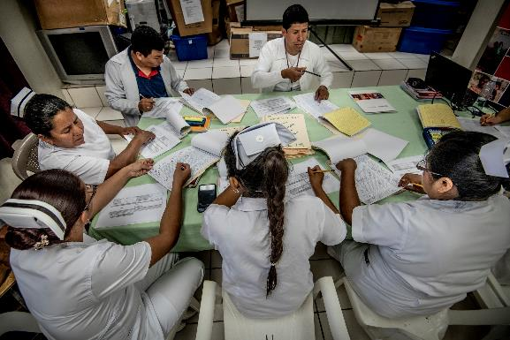
Part 1: Latest global data
Latest global estimates
Your country’s data
© Karen Kasmauski/ MCSP
Notes:
READ THE SLIDE

Slide 6
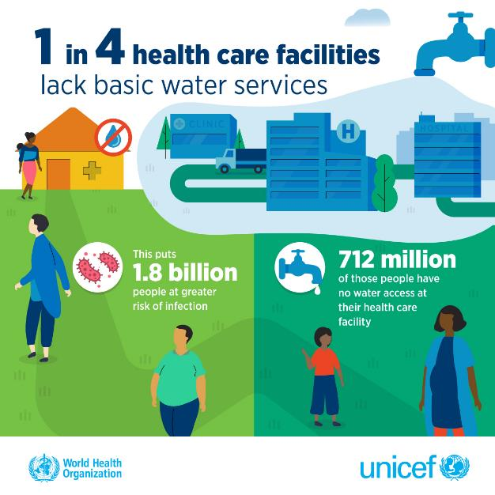

Globally, the fundamentals are still missing
https://washdata.org/data/healthcare
Notes:
READ THE SLIDE
SAY:
the WHO/UNICEF Joint Monitoring Programme regularly reports on water, sanitation, hand hygiene, health care waste and environmental cleaning services in health care facilities as part of official reporting responsibilities for SDG 6 on WASH.
Data are based on nationally representative health care facility assessments and are extracted from dozens of different types of surveys.
The latest data represents 2019 and was published in 2020. The next update will be published in 2022. You can find updates at the website

Slide 7
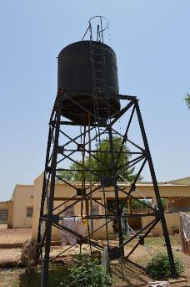

Latest global data for WASH in health care facilities (2019)
    1 in 10 have no sanitation
    1 in 3 lack hand hygiene at point of care
    1 in 3 lack systems to segregate waste
    Services drop by 50% in Least Developed Countries
    Major data gaps, especially for environmental cleaning
Data from 164 countries online
(from 473 different data sources)
    Find your country’s data: www.washdata.org/healthcare
WHO/UNICEF publishes new data every two years. For the latest reports and data refer to www.washdata.org/healthcare.
Notes:
READ THE SLIDE
SAY:
This is the first global baseline estimate of WASH in health care facilities
Data are from 2019, published in 2020

Slide 8
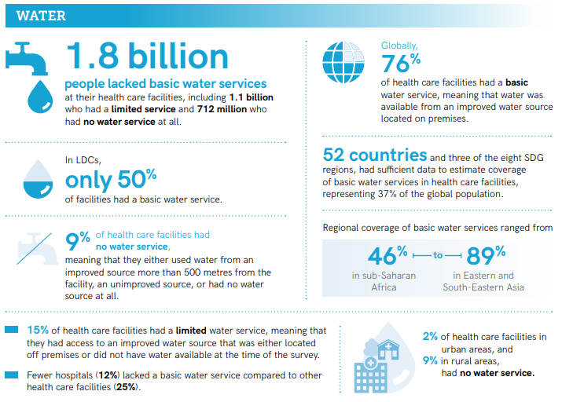
Source: WHO/UNICEF, 2020. Fundamentals first: global progress report on WASH in health care facilities. https://www.who.int/publications/i/item/9789240017542
Notes:
SAY:
Here are more global data for you to understand the scale of the problem.

Slide 9
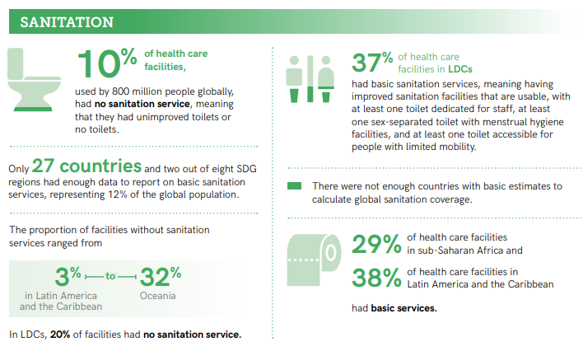
Notes:
READ KEY FACTS FROM THE SLIDE

Slide 10
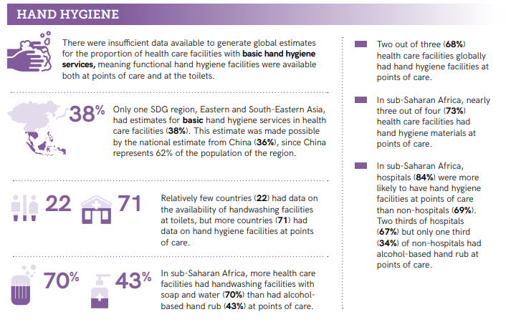
Notes:
READ KEY FACTS FROM THE SLIDE

Slide 11
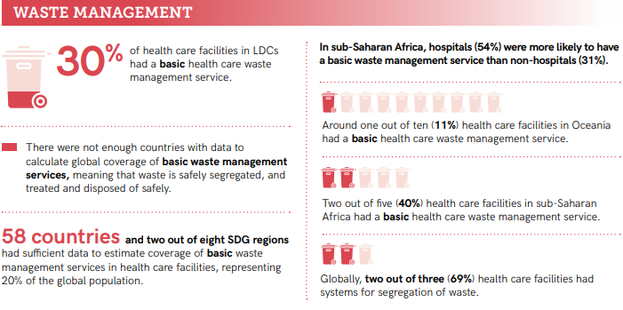
Notes:
READ KEY FACTS FROM THE SLIDE

Slide 12
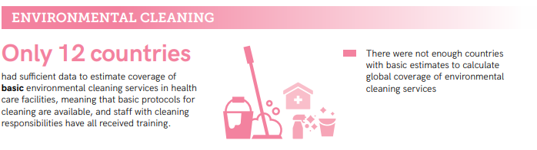
Notes:
READ KEY FACTS FROM THE SLIDE

Slide 13
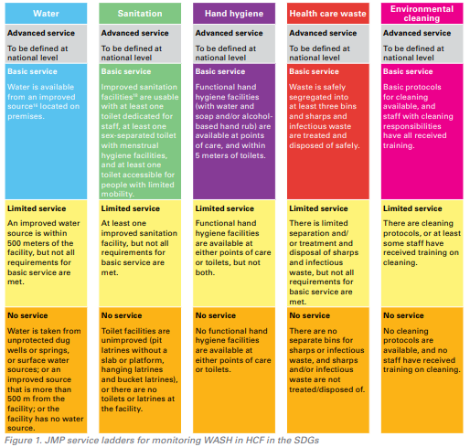
Global monitoring indicators and definitions
Notes:
SAY:
This slide describes what are the indicators used to describe the situation which was just presented in the previous slides.
The WHO/UNICEF Joint Monitoring indicators and service ladders (no service, limited service, basic and advance service) are drawn from existing WHO guidance. These indicators, however, do not cover the full extent of minimum standards due to difficulty of measuring and lack of global data. For example, water quantity, water storage and water quality are not included in the basic definition of water, nor are aspects of climate resilience such as minimizing water leakages and raising storage.
Thus, it is important to consider that while the WHO/UNICEF figures provide an important starting point for understanding WASH services (and gaps) they are not the end point.
Find out more about the ladders and core questions, visit: https://www.who.int/publications-detail-redirect/9789241514545. The document is available in other UN languages.

Slide 14
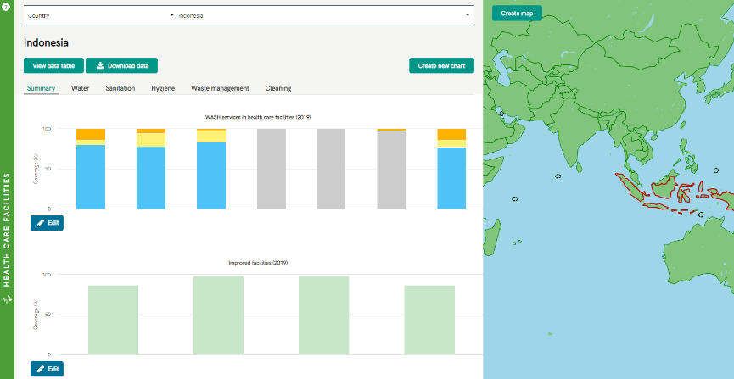
Insert snapshot of your country data here
Country context
Visit www.washdata.org - view and download country files
Search data by world, region or country
Download Excel country data file
Service ladders show (from top to bottom):
No service
Limited service
Basic service
Notes:
NOTE FOR TRAINER:
This slide is to be adapted to the country context.
If it is possible to insert local data – read out the data from the slide

Slide 15

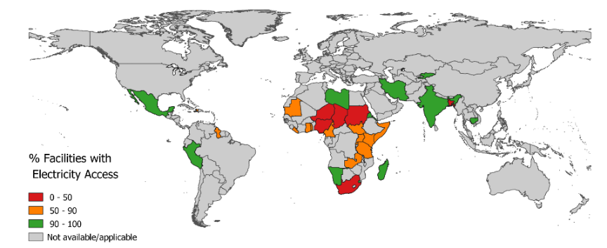
Rationale
Energy access also fundamental and suffers from large gaps in access (global)
% of health care facilities with electricity, by country
Learn more on efforts to power health care facilities at Sustainable Energy for All: https://www.seforall.org/powering-healthcare
HCF
1 in 4 primary care facilities have no power
35% of hospitals lack reliable power
Notes:
SAY:
Despite the fundamental role that electricity plays in health care provision, many health care facilities do not have access to electricity.
Updated: total number of surveys in database is 34 from 23 countries.
This slide shows the most recent data on access to electricity in health care facilities
Of the data available, many health care facilities lack adequate access to electricity.
As many as 1 in 4 health posts (primary level of care) have no electricity at all.
-Increasingly WHO and partners are working to jointly advocate for, finance, monitoring and improve WASH and energy in health care facilities as the two are linked (e.g. you need lighting in toilets and energy to pump water) and often are both included in one “bundle” of health infrastructure when it comes to health financing and budgets.
But the picture is much more complex than this. Many facilities that technically have access (i.e. are connected to the grid) do not have good quality or reliable access. Nearly 35% of hospitals surveyed report that they do not have reliable access to electricity. So while we are focused on providing access where there is none, it is important that we do not also overlook facilities where reliability of access is a major concern.

Slide 16
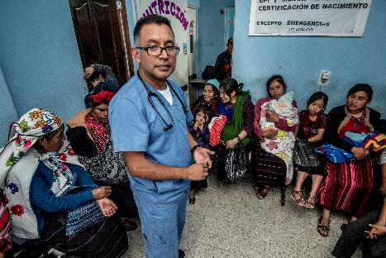
Part 2: Other relevant health initiatives
Quality of care
Infection, prevention and control
Antimicrobial resistance (AMR)
COVID-19
© Karen Kasmauski/ MCSP

Slide 17
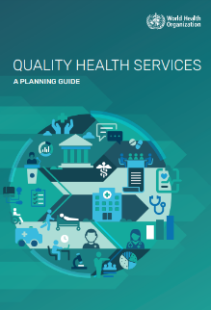
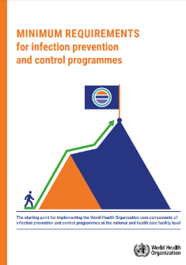
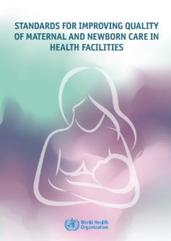
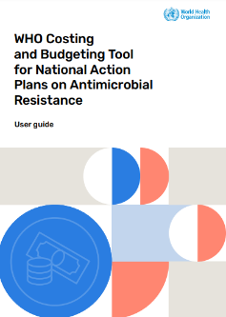
WASH in health care facilities – a key component of health strategies and standards
For Antimicrobial resistance
Quality health care & UHC
Maternal & child health
IPC
Notes:
SAY:
WASH in health care facilities is included in many global health strategies and standards and recognized as a fundamental element to achieving health goals. Specifically:
For quality health services-WASH in health care facilities saves costs in the health systems through reduced health care associated infections and reduced need for medication, greater staff morale and improved performance and greater uptake of health care services and satisfaction of care. WASH in HCF standards, monitoring and resources ought to be included in any national efforts on quality health services.
WASH in HCF is essential for IPC practices and IPC actors have a role in advocating for, monitoring and collaborating with WASH actors on using joint tools and approaches.
If you are interested you can learn more about minimum IPC requirements
The standards for improving quality of maternal and newborn care identify WASH as one of 8 critical areas for improving the provision and experience of care around time of childbirth. Improving water services, toilets, showers and hand hygiene within maternity settings can significantly improve health outcomes for mother and child. The Network for Improving Quality of Care for Mothers, Newborns and Children (Quality of Care Network) works to implement these standards in 11 focus countries on dedicated quality improvement (QI) efforts and is an important platform for sharing lessons learned globally.
Antimicrobial resistance is a growing threat and WASH in health care facilities is needed to prevent AMR infections, prevent spread of AMR in the environment (e.g. through safely managed sanitation/wastewater) and ensure safe and effective treatment of those that have antibiotic resistant infections. Including WASH in HCF plans, budgets and monitoring with national Antimicrobial Resistance plans is one important means by which to increase political buy-in and multisectoral action.

Slide 18
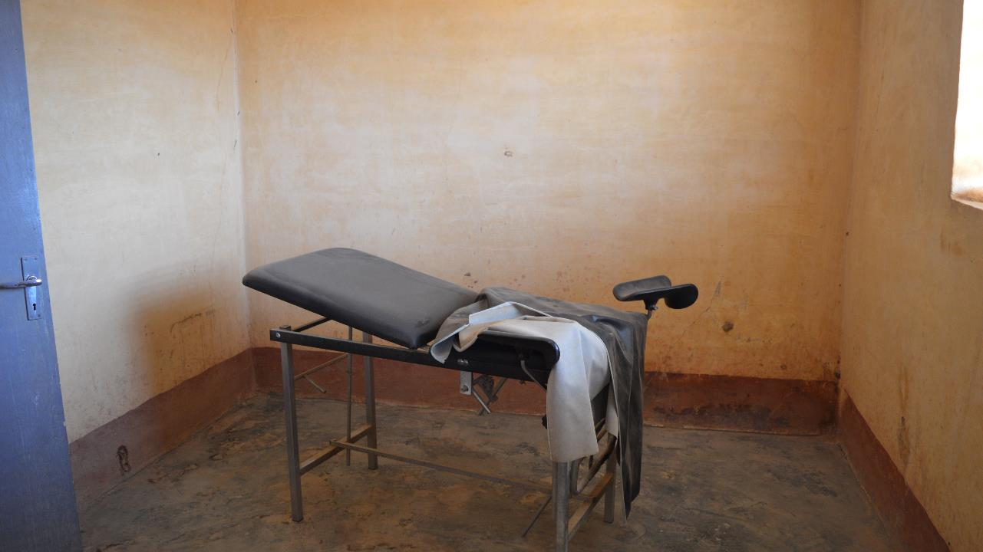
“QUALITY” - an empty promise without the fundamentals (basic services)
8.6 million deaths per year in 137 LMICs are due to inadequate access to quality care.
Of these, 3.6 million are people who did not access the health system.
Whereas 5.0 million are people who sought care but received poor quality care.
Up to 1.0 million mothers and newborns die from preventable infections linked with unclean births.
https://www.thelancet.com/pdfs/journals/langlo/PIIS2214-109X(17)30101-8.pdf
https://www.healthynewbornnetwork.org/hnn-content/uploads/CBK_brief-LOW-RES.pdf
Notes:
READ THE SLIDE
SAY:
The picture shown here is a delivery room in a rural primary health care facility in a country in the Sahel.

Slide 19


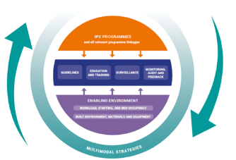
WASH & infection prevention and control (IPC) – together making health care safer
Think about the following:
What do you think the relationship is between WASH and IPC?
What part of your WASH guidance addresses and explains IPC?
What aspects of training address both WASH and IPC?
5 min exercise
Notes:
SAY:
Talk in pairs for a few moments, thinking about the WASH-IPC relationship and be ready to shout out some answer to the questions
THEN SAY:
There are many interlinkages between WASH and IPC – it is important to understand that WASH and IPC are complementary and there is a strong rationale for effective relationships between those tasked with addressing WASH and IPC

Slide 20
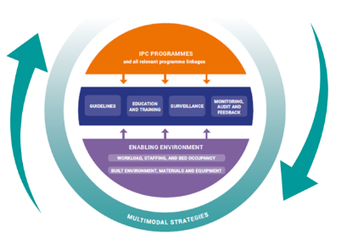
WASH & IPC – together making health care safer
To provide clean care, combat outbreaks, antimicrobial resistance and ongoing infections in health care, countries need to have effective IPC programmes and functioning WASH services in place.
IPC is an evidence-based and practical solution to prevent harm to patients and health workers by stopping the spread of infection through specific actions
WHO has identified 8 core components for IPC programmes in health care
WASH is part of an enabling environment (known as core component 8)
https://www.who.int/teams/integrated-health-services/infection-prevention-control
Notes:
READ THE SLIDE
SAY:
the coloured visual represents what are described as the WHO IPC core components – these are evidence based guidelines that all countries should follow and they do incorporate aspects of WASH as a core element of IPC
WASH has critical connections to these IPC core components, although WASH is about more than just preventing infection (i.e. it impacts dignity)
nonetheless, WASH provides the necessary infrastructure, materials and equipment enabling the implementation of appropriate IPC practices and supporting behavioural change among health workers and the community. This is represented in the diagram by the purple segment
You can read more in a number of IPC and WASH publications

Slide 21
Minimum requirements of IPC programmes
To achieve strong, effective IPC programmes at the national and facility level, countries should have the minimum requirements in place
→ the starting point for providing basic protection and safety to patients, health workers and visitors
WASH is a minimum requirement within core component 8: Built environment, materials & equipment for IPC
Notes:
READ THE SLIDE
SAY:
Emphasise that the IPC minimum requirements are the starting point for providing basic protection and safety to patients, health workers and visitors, and to progressively fully establish all IPC core components

Slide 22
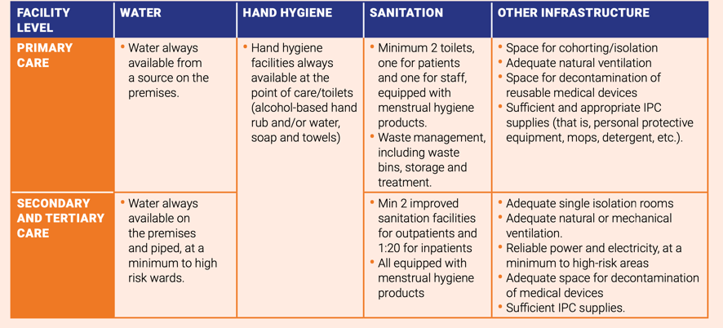
Minimum WASH requirements
For supporting the built environment, materials & equipment for IPC
Notes:
READ THE SLIDE
SAY:
WASH is represented in IPC core component 8 which recommends that patient care activities should be undertaken in a clean and/or hygienic environment that facilitates practices related to the prevention and control of infection.
This includes all elements related to the WASH infrastructure and services, as well as the availability of appropriate IPC materials and equipment.

Slide 23
WASH – a building block to achieve better IPC
Linkages
In particular with those providing waste management, sanitation and water supply services but also hygiene services, e.g. hand hygiene, cleaning.
Guidance
Waste management, adequate access to safe water, a reliable electricity supply, sanitation and environmental cleaning.
Multimodal improvement
WASH infrastructure is a critical element of multimodal improvement strategies explained by WHO.
Accountability
WASH & IPC monitoring should provide information on the existence and functioning of the WASH infrastructure.
https://washinhcf.org/resource/combatting-amr-through-wash-and-ipc-in-healthcare/
Notes:
SAY:
This slide presents some key principles related to the IPC core components and how WASH can be seen as a building block for IPC in health care
Linkages: The IPC team should have established links and communication mechanisms, in particular with those providing waste management, sanitation and water supply services.
Guidance: Should include reference to waste management, adequate access to safe water, a reliable electricity supply, sanitation and environmental cleaning.
Multimodal improvement: Building and continuously operating and improving the WASH infrastructure is a critical element of multimodal strategies, which have proven to be the most successful approach for implementing IPC interventions in health care. Explain that the Hand Hygiene module presents a comprehensive outline of the multimodal strategy.
Accountability: WASH & IPC monitoring should provide information on the existence and functioning of the WASH infrastructure, such as water and electricity supplies, toilets, and health care waste disposal and treatment
the WASH AMR IPC leaflet which is visualized on the right of the and encourage participants to read this as an example of what action focused linkages might look like in real life

Slide 24
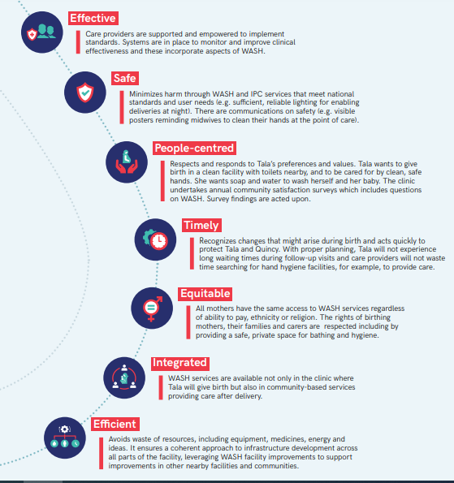
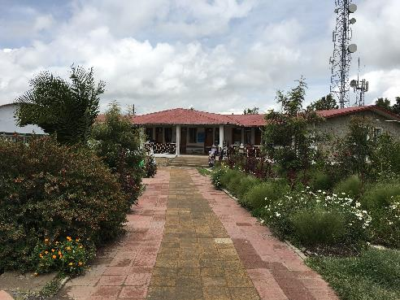
WASH & IPC contribute to seven elements of quality care
1. Timely
2. Efficient
4. Integrated
5. Effective
6. Safe
WASH supports & strengthens IPC to prevent: i) the spread of infection, ii) the overuse/unnecessary use of antibiotics & iii) outbreaks
https://www.who.int/water_sanitation_health/publications/wash-in-health-care-facilities-global-report/en/
Notes:
SAY:
Let's bring this to life by focusing on a topic of interest today – the prevention and control of infection (IPC) and how WASH plays such an important role in supporting efforts to stop preventable infection in health care as part of overall efforts to improve the quality and safety of health care.
This slide provides a quick recap on what is meant by quality health care.
Quality health care is timely, efficient, equitable and integrated - delivered in a seamless way for people who access it.
Thinking about WASH – one way to look at this is that a lack of WASH in health care means care is less effective, less safe & harmful.
If we think specifically about IPC - WASH supports & strengthens IPC to prevent: i) the spread of infection, ii) the overuse/unnecessary use of antibiotics & iii) outbreaks.
WASH is a building block for the delivery of quality health care for people.

Slide 25
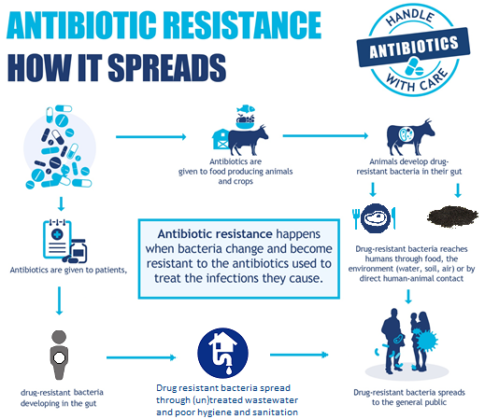
Water, sanitation and hygiene are fundamental to preventing AMR
Good manufacturing practices including wastewater treatment
Animal hygiene, treatment and safe use wastewater and manure
Universal access to WASH (SDG 6.1 &6.2) in households to prevent avoidable use
Universal access to WASH in health facilities
Safe disposal of unused medicines
Research - Relative contribution from each source to AMR and health
Improve wastewater treatment for all sewage (SDG6.3)
Notes:
SAY:
This information from the WHO AMR promotions highlights specifically the linkage with AMR

Slide 26
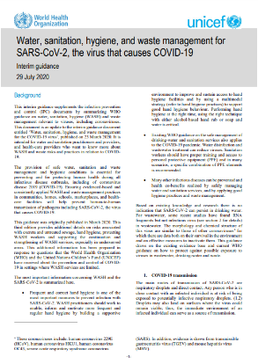
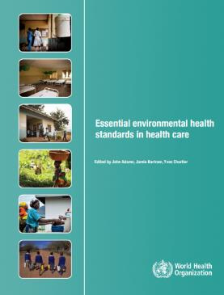
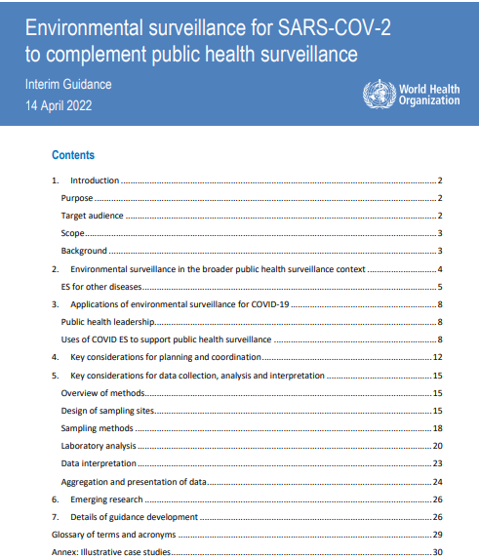
COVID-19 & WASH guidance
Frequent and proper hand hygiene one of the most important preventative measures.
Existing WHO guidance on the safe management of drinking-water, sanitation, hand hygiene and health care waste services applies to COVID-19; additional measures not needed.
Many other infectious diseases can be prevented, and health co-benefits realized by safely managing water and sanitation services, and by applying good hygiene practices and waste management
WASH services in health care facilities should be prioritized and included in all government COVID-19 response plans.
https://www.who.int/publications-detail/water-sanitation-hygiene-and-waste-management-for-covid-19
Notes:
READ THE SLIDE

Slide 27
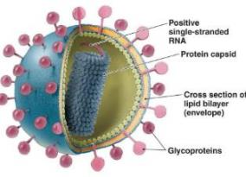
COVID-19 & WASH Evidence
Enveloped virus, surrounded by weak lipid membrane
WATER: SARS-CoV-2 (virus that causes) is not found in nor transmitted through drinking-water
WASTEWATER: SARS-CoV-2 is not transmitted through wastewater; monitoring fragments of SARs-CoV-2 however can be an effective tool for understanding epidemiological trends
Not fecal oral; relatively fragile in the environment and will become inactivated faster than non-enveloped human enteric viruses (e.g. adenoviruses, norovirus, rotavirus, hepatitis A)
Few patients have diarrhea (2-10%)
Notes:
READ THE SLIDE

Slide 28
COVID-19
Main messages
Hand hygiene: Frequent and effective hand hygiene is an important prevention measure. All health care facilities and public areas should have hand hygiene facilities.
Environmental hygiene: Effective inactivation on surfaces can be achieved within 1 minute using common disinfectants.
Water, sanitation and waste: Existing WHO guidance on the safe management of drinking-water and sanitation services applies to the COVID-19 outbreak. Disinfection important and effective.
WASH investments and actions: Should be fundamental to all country preparedness and response plans. No regrets investment.
Health care waste: Efforts needed to reduce and safely treat COVID-19 health care waste, including regular segregation, reducing unnecessary use of gloves and improving hand hygiene, reducing packaging, more centralized, non-burn treatment and increased funding for health care waste personnel and treatment technologies.
Notes:
READ THE SLIDE

Slide 29
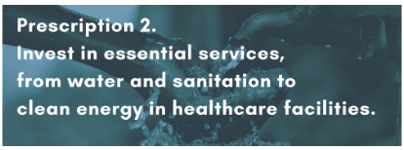
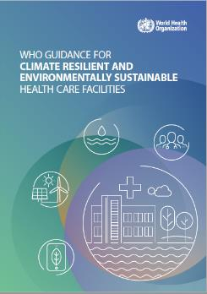
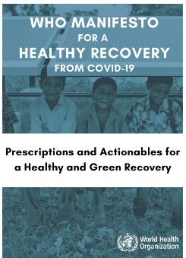
WASH and energy
Central to a healthy recovery from COVID-19
All WASH investments should support climate resilience and protect environment
Simple interventions include low-cost autoclaves to treat waste, segregation and recycling of non-infectious waste, raised, water storage, using energy efficient lighting, installing solar power
Efforts should align with climate resilient health care facilities
https://www.who.int/news/item/12-10-2020-who-publishes-guidance-on-climate-resilient-and-environmentally-sustainable-health-care-facilities
Notes:
READ THE SLIDE
SAY:
Climate resilient and environmentally sustainable health care facilities are those that can better withstand climate shocks and extreme weather events, safely serve users when those events occur, have low or no carbon emissions and have minimal impact on the environment including through waste and chemicals.

Slide 30
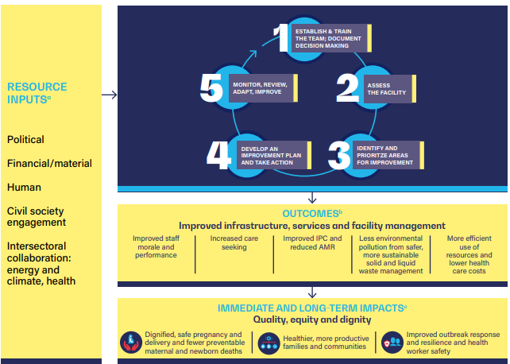
How can WASH FIT help address these issues?
Notes:
SAY:
WASH FIT can be used to address all of the health issues previously mentioned. This illustrates the outcomes and expected immediate and long-term impacts from using WASH FIT. For a detailed description of the methodology, refer to the next module.

Slide 31
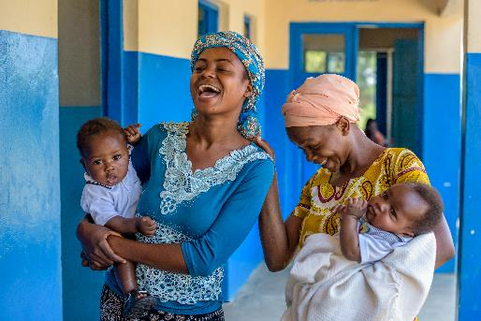
Part 3: Global guidance and frameworks
Global targets and metrics
2019 Resolution on WASH in health care facilities
The WHO/UNICEF 8 practical steps
What countries are doing and how they are being tracked
Global analysis of investments needed to improve WASH in health care facilities
Notes:
READ THE SLIDE

Slide 32
Global targets for WASH in health care facilities
Basic services
Higher service levels
By 2020, 60% of all health care facilities globally, and in each SDG region, have at least basic WASH services;
By 2025, 80% have basic WASH services, and
By 2030, 100% have basic WASH services
By 2022 higher levels of service are defined and monitored in countries where universal basic WASH services have been achieved already;
By 2030, higher levels of WASH services are achieved universally in 80% of those countries
Notes:
READ THE SLIDE
SAY:
A global Call to action on WASH in health care facilities, issued by the United Nations (UN) Secretary General in 2018, urged all Member States, UN agencies and partners to commit leadership and resources to addressing this fundamental challenge. In response, WHO and UNICEF developed a corresponding global workplan with these targets and a set of related metrics to guide action. These targets were agreed in 2018 and align with SDG 6.
Basic services are tracked using JMP data (see slides 6-8). Higher service levels may be defined at the country level for those countries who have already achieved basic services levels or for those countries where basic service levels are not ambitious enough.

Slide 33
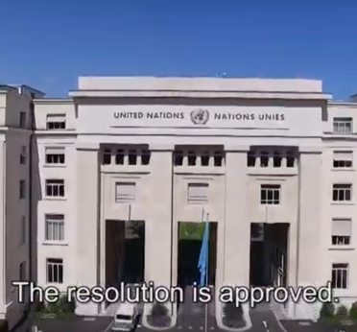
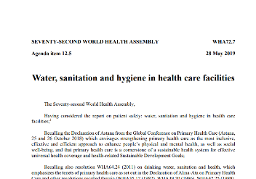
World Health Assembly Resolution 72.7 (2019)
Calls for ALL Member States to:
Establish national roadmap, targets and implement WASH in HCF and infection prevention and control (IPC) standards
Integrate WASH and IPC standards and indicators into health programming and monitoring
Address inequities, especially in primary health care facilities and facilities where births occur
Increase domestic funding for WASH in HCF
Calls for the WHO Director General to:
Provide leadership, technical guidance and regularly report on status
Mobilize partners and investments
Available at
http://apps.who.int/gb/ebwha/pdf_files/WHA72/A72_R7-en.pdf
Notes:
READ THE SLIDE
SAY:
The WHA Resolution was passed in 2019 and has the backing of ALL 194 Member States.
WHO is responsible for reporting on progress every 2 years (May 2021 and May 2023). The contents of the Resolution map to the WHO/UNICEF 2019 8 practical steps. See next slide for details of the 8 steps.

Slide 34
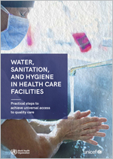
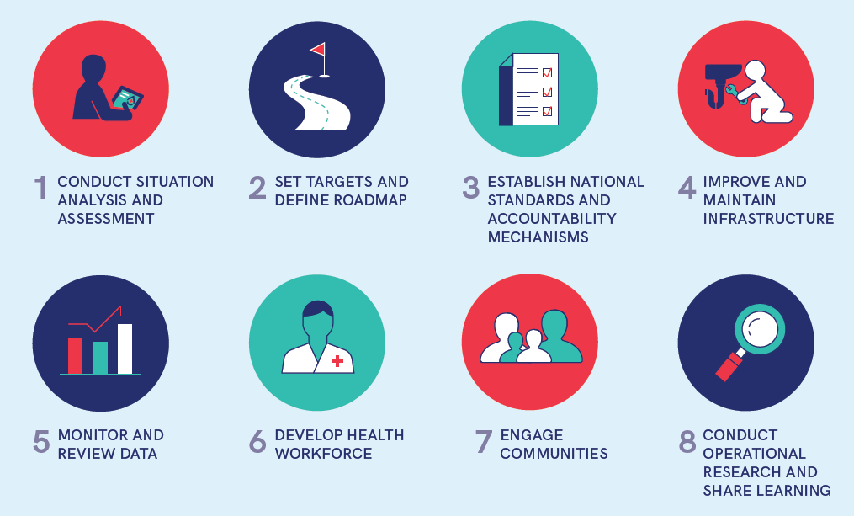
Eight practical steps
WHO/UNICEF guidance for action reflected in the Resolution
40+ countries implementing WASH FIT
Notes:
SAY:
At least 60 countries are known to be progressing on developing standards, targets and funded road maps to scale up WASH in HCF through the tracking conducted by WHO/UNICEF.
These were published in 2019 by WHO and UNICEF and the basis for action related to WASH in HCF. The Resolution includes all eight actions, thus countries have committed to addressing these and reporting on them every two years at the World Health Assembly.
These 8 practical steps were published by WHO and UNICEF in 2019 and are those activities which LMIC countries need to undertake to sustain WASH services and practices in a range of health care settings, from primary to tertiary facilities. The eight steps are presented in a linear fashion, however, the actions can occur in various orders and/or simultaneously. Some actions are undertaken at the national level and some at the subnational or facility level. Some may apply to all levels.
Where step is WASH FIT?
Practical steps 1-3 should ideally be completed before beginning WASH FIT.
Conduct situational analysis: what policies, standards and guidelines are in place for guiding and implementing WASH and IPC? Who are the relevant national, sub-national and local stakeholders who are responsible for WASH in HCF and who may have a role to play in WASH FIT?
What national targets have been set? How will WASH FIT be used to help reach those targets? Is it a requirement for facilities to use WASH FIT?
Do national standards exist? If so, WASH FIT can help facilities work towards those standards. Has the WASH FIT assessment tool been updated to match national standards?
4. WASH FIT helps facilities to improve infrastructure and strengthen routine operation and maintenance.
5. Collecting regular data, both through routine data collection systems (e.g. Health management information systems – HMIS) and sharing results from regular WASH FIT assessments. These should be shared with the district health office, national government and/or implementing partner (if appropriate).
6. WASH FIT includes indicators on staffing, training, protocols, management and staff incentivization. Is it critical to have a well-trained, motivated and protected (i.e. through good occupational health) workforce.
7. The community has an important role to play, demanding change and providing feedback to the facility. At the least, a community member should be represented on the WASH FIT or QI committee.
It is important to know what is working and what could still be improved in a HCF.
8. Documenting case studies and experiences of using the tool will help to improve the methodology and guidance over time. Please share any feedback you have with WHO and UNICEF at washinhcf@who.int.

Slide 35
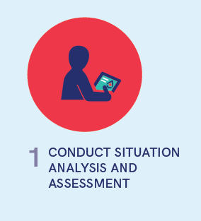
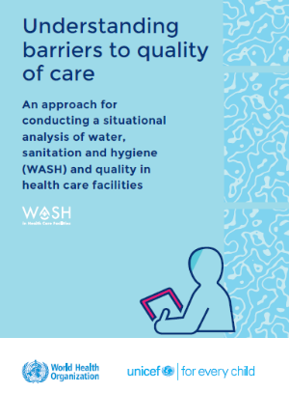
Practical step 1
  A situation analysis examines health and WASH policies, governance structures, and funding streams
  An assessment provides updated figures on WASH coverage and compliance
  Together, these documents form the basis for prioritizing action and mobilizing resources
  Informs all subsequent steps
  The above document describes how to conduct a situational analysis, with a number of country examples.
  https://apps.who.int/iris/handle/10665/340297
Notes:
READ THE SLIDE

Slide 36
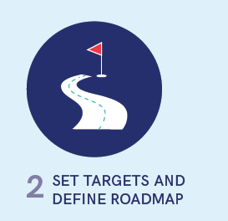
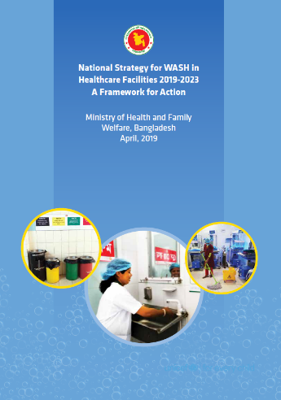
Practical step 2
Government sets detailed targets (with a national roadmap detailing how the country will reach those targets
Supported by an intersectoral national team or technical working group
Plans should clearly define the approach, intervention areas, responsibilities, targets, and budget for WASH improvements over a defined time period.
Plans should include costing estimates with costs for capital investments, rehabilitation, as well as recurrent costs associated with operation and maintenance.
  Visit www.washinhcf.org/resources for examples of national roadmaps and strategies.
Notes:
READ THE SLDIE

Slide 37
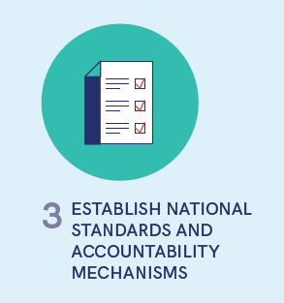
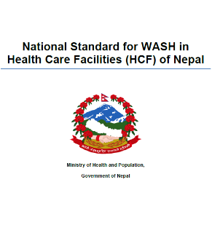
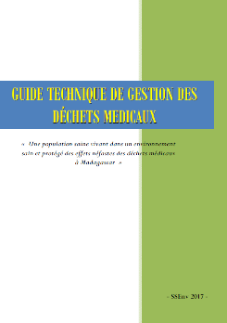
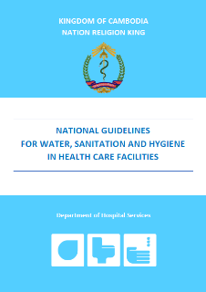
Practical step 3
  National standards provide the basis for design, costing, implementation and operation of WASH services.
  Must reflect the national context, be disseminated and implemented
  Accountability mechanisms ensure that all facilities meet national standards.
  Nearly all countries have, or are updating, standards on WASH and/or waste in HCF
Notes:
READ THE SLIDE
SAY:
This step is tracked in two components: standards on WASH in HCF (general) and standards on health care waste management. In most countries, these are separate documents, but some combine into one,.

Slide 38
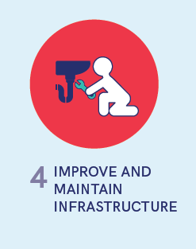
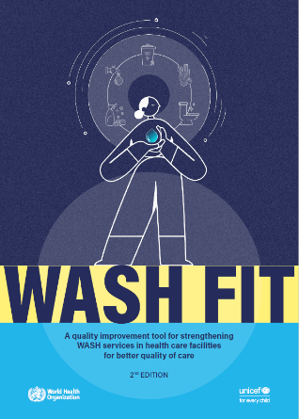
Practical step 4
  WASH infrastructure is improved and maintained to meet national standards
  Requires policies, resources, and strategies to keep infrastructure and services operational over time.
  Existing infrastructure is upgraded or retrofitted to be climate-resilient, and climate-friendly options are chosen for any new infrastructure
  WASH FIT is just one example of an improvement tool – countries may have existing programmes
Notes:
READ THE SLIDE

Slide 39
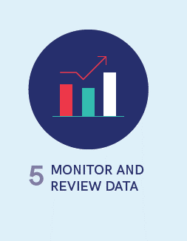
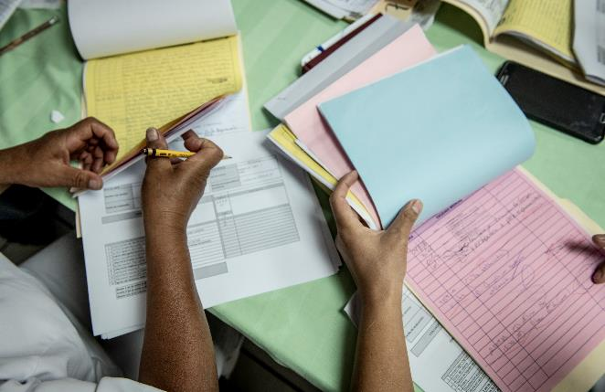
Practical Step 5
  WASH indicators can be integrated into routine data collection and review processes for health care, e.g., health management information systems
  Data are routinely collected, analysed and results shared
  The data can be used to measure progress and hold stakeholders accountable.
Notes:
READ THE SLIDE

Slide 40
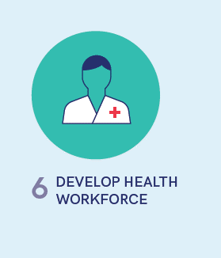

Practical step 6
All workers engaged in the health system, from doctors, to nurses, midwives, and cleaners should have access to up-to-date information on WASH and IPC practices
Pre-service training and as part of regular professional development.
Training of nurses in gender equality, disability and social inclusion (GEDSI) issues in Myanmar, © WaterAid
Notes:
READ THE SLIDE

Slide 41


Practical step 7
  Community members serve an important role in defining, demanding, using and providing feedback on health services.
  Include community in the development of WASH policies and in the regular review of WASH coverage and implementation data.
  Community plays an important role in WASH FIT
A community representative takes part in the WASH FIT team discussions in Ghana
Notes:
READ THE SLIDE
SAY:
community engagement is featured as part of WASH FIT in the methodology module.

Slide 42


Practical step 8
External review and research is important for testing and scaling-up innovative approaches and reflecting on and revising programmatic strategies.
Helps to understand the problem (what, how and why), what to do about the problem and where investments should be prioritized.
© WHO/Uma Bista
Notes:
READ THE SLIDE

Slide 43


Country progress tracker
60+ countries making progress on implementing World Health Assembly Resolution & Practical Steps
Visit: https://washinhcf.org/country-progress-tracker/ to submit an update for your country
Notes:
SAY:
The country tracker can be found at https://washinhcf.org/country-progress-tracker/. It tracks country progress on 6 of the 8 practical steps.
Health partners in child/maternal health, AMR, IPC, vaccines and emergencies using tracker to better understand and target efforts
For full details of how countries are tracked, refer to page 124 of Fundamentals First.
Data were collected through four main ways: a questionnaire distributed to countries through WHO and UNICEF regional offices between September 2019 and April 2020; review of resources posted on www.washinhcf.org and presentations and information shared at regional and country events and conferences; information shared by implementing
partners; and follow up phone interviews with WHO and UNICEF country offices and government counterparts. Following data extraction, the tracker was sent to WHO and UNICEF country offices for validation by respective government counterparts. Where available, corresponding documents (e.g. copies of national standards, training reports) have been uploaded to www.washinhcf.org/resources and can be found by searching by country.

Slide 44
Progress is being made but more to be done
But there is more to be done!
Notes:
SAY:
These infographics summarise the country progress data from the 2020 Fundamentals First report. The figures have been slightly updated since this publication (with new countries being added) but the general statistics remain similar. The majority of countries have, or are working on standards, and have conducted situational analyses and developed roadmaps.

Slide 45

Examples of actions in champion countries
LAO PDR. Over 2 million USD raised through COVID-19 national funding mechanisms to implement climate resilience WASH standards, hand hygiene practices and technologies.
MALI. National WASH in HCF taskforce and integration of indicators into routine electronic monitoring platform allows identification of gaps, important in a protracted emergency situation
COLUMBIA.
the First Lady, has started a regional coalition of political advocates and spokespersons.
CAMBODIA. Research to address hygiene behaviours around birth, resulting in a context-specific multimodal intervention for quality improvement
GHANA. Communities rate services and contribute to solutions for improving quality which are tracked through the national health monitoring system.
45
Notes:
NOTE FOR TRAINER:
This slide may be modified to include different countries examples that are more relevant to the national/regional/local context.
SAY:
This image is taken from Fundamentals First (page 50-51). The document contains case studies for all countries highlighted on the map describing which practical steps they have implemented and how. Further information on country progress can be found on www.washinhcf.org in the Stories (https://washinhcf.org/search-updates/) and Resources (https://washinhcf.org/resources/) sections.
If you have other examples of country work, please share with washinhcf@who.int or via the website at https://washinhcf.org/share-your-story/.

Slide 46
Investing in WASH: modest costs and high return
Achieving universal basic WASH by 2030 in all LDCs will cost, on average, US$ 6.5-9.6 billion; equal to 0.60$/capita/year
Annual costs for WASH in health care facilities in LDCs are 3% of annual recurrent government spending on health and 3% of the annual universal WASH price tag.
 | All facilities |  | Hospitals |  | Non-hospitals
 | cost, billion US$ | % | cost, billion US$ | % | cost, billion US$ | %
Water | 1.5 | 20 | 0.05 | 0.7 | 1.5 | 19
Sanitation | 1.8 | 23 | 0.08 | 1 | 1.7 | 22
Hygiene | 0.8 | 11 | 0.12 | 1.5 | 0.7 | 9
Waste Management | 3.7 | 46 | 0.2 | 3.1 | 3.4 | 44
…but highest costs for waste management & primary health care
Source: Chaitkin, et al., 2022; Estimating the cost of achieving universal basic WaAH in heatlh care facilities in the 46 UN designated least developed countries. Lancet Global Health. https://www.thelancet.com/journals/langlo/article/PIIS2214-109X(22)00099-7/fulltext
Notes:
READ THE SLIDE
SAY:
The costs for WASH in health care facilities are modest compared to current government spending on health. However many facility, district and national health budgets do not allocate funds to support recurrent costs of maintaining WASH infrastructure. Thus such budget lines need to be included and WASH and health actors needs to engaging in health financing policy dialogue to support appropriate inclusion of such costs.
The range for operation and maintenance is the per capita cost in 2030; it would cost only $0.10 in year 1 and then scale up each year as more infrastructure is installed.

Slide 47

Global recommendations for action
What can you or your organization do to help?
Notes:
SAY:
These are the recommendations from the 2020 Fundamentals First report for action at the global level. These recommendations still remain true. Ask participants how these recommendations relate to their experience? Could they act on any of them in their work?

Slide 48

WASH and health leaders and implementers - your voice and action matters!
Learn and engage
Understand the status of your country/facility
Reach out to HEALTH actors to engage in collective efforts
Connect
Join the conversation and share your questions & comments @WASH_for_health
Visit www.washinhcf.org/contact and submit resources to the knowledge portal
Commit and act
Contribute to four main global recommendations
Collaborate with Ministry of Health and partners on practical steps to advance WASH in Health Care Facilities and WASH FIT
WASH in health care facilities global knowledge portal
www.washinchf.org
Notes:
READ THE SLIDE
SAY:
Four global recommendations are shown on the previous slide. These recommendations are published in Fundamentals First (2020).

Slide 49
Further reading
General
WHO/UNICEF 2018. Water and Sanitation for Health Facility Improvement Tool (WASH FIT). https://www.who.int/publications/i/item/9789241511698
WHO, 2008. Essential environmental health standards in health care. https://www.who.int/publications/i/item/9789241547239
Water
WHO, 2011. Guidelines for drinking-water quality, 4th edition. World Health Organization, Geneva. https://www.who.int/publications/i/item/9789241549950
WHO, 2019. Results of Round II of WHO International Scheme to Evaluate Household Water Treatment Technologies. https://apps.who.int/iris/handle/10665/325896
Sanitation
WHO, 2018. Guidelines on sanitation and health. World Health Organization, Geneva. https://www.who.int/publications/i/item/9789241514705
Waste
WHO, 2014. Safe management of wastes from health care activities. Second Edition. World Health Organization, Geneva. https://www.who.int/publications/i/item/9789241548564
WHO, 2017. Safe management of wastes from health care activities: a summary. World Health Organization, Geneva. https://apps.who.int/iris/handle/10665/259491
WHO, 2019. Overview of treatment technologies for infectious and sharp waste from health care facilities. https://apps.who.int/iris/handle/10665/328146

Slide 50
Further reading
Environmental Cleaning
CDC, 2019. Best practices for environmental cleaning in health care facilities: in resource limited settings. US Centers for Disease Control. USA. https://www.cdc.gov/hai/pdfs/resource-limited/environmental-cleaning-508.pdf
COVID 19
Technical brief on WASH and COVID-19 https://www.who.int/publications/i/item/WHO-2019-nCoV-IPC-WASH-2020.4
WHO, 2020. Infection prevention and control during health when novel coronavirus (nCoV) infection is suspected. https://www.who.int/publications/i/item/10665-331495
Emergencies
WHO/WEDC, 2013. Technical notes on water, sanitation and hygiene in emergencies. World Health Organization, Geneva. https://www.who.int/teams/environment-climate-change-and-health/water-sanitation-and-health/environmental-health-in-emergencies/technical-notes-on-wash-in-emergencies
Quality of care & IPC
WHO (2016) Standards for improving quality of maternal and newborn care in health facilities https://www.who.int/publications/i/item/9789241511216
WHO (2016) Global guidelines on the prevention of surgical site infection http://www.who.int/gpsc/ssi-guidelines/en/
WHO Clean Care is Safer Care http://www.who.int/gpsc/5may/en/

