Slide 1
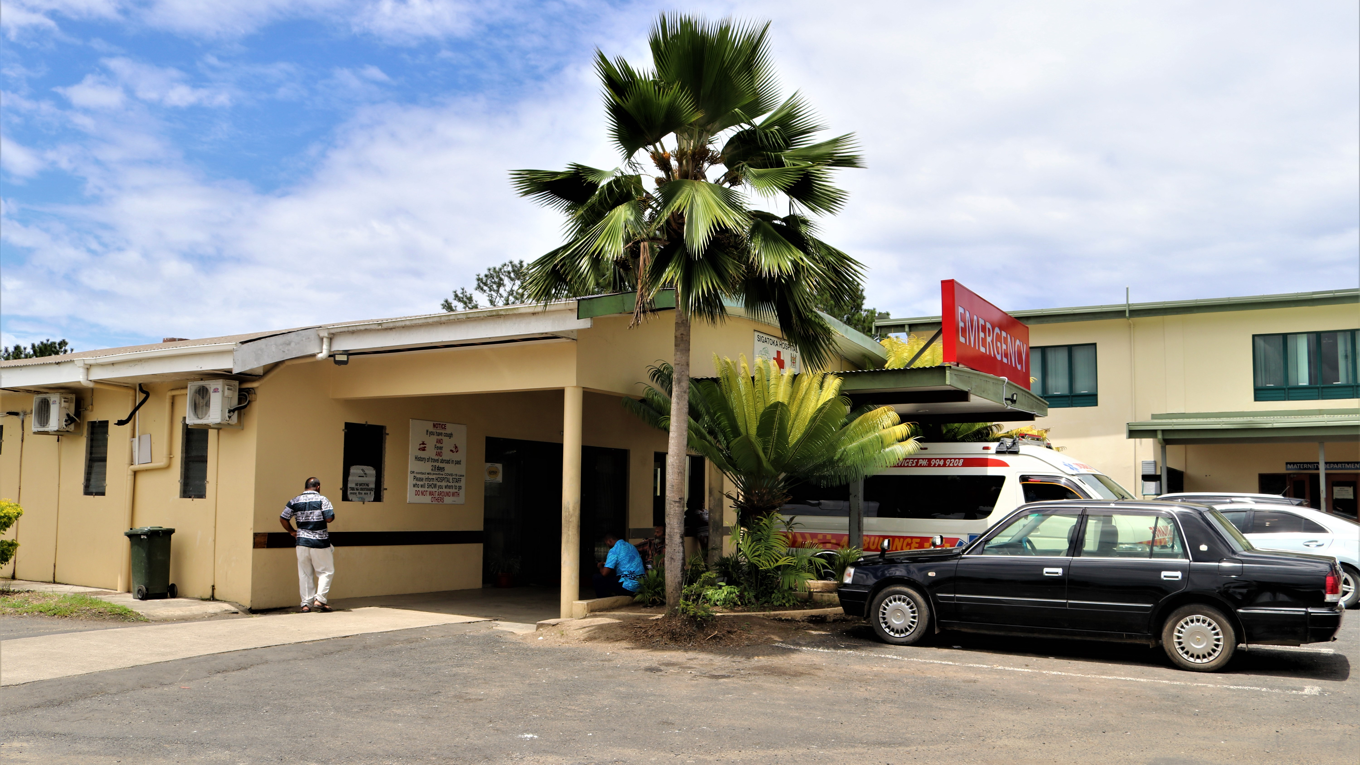
Module 4
Conduct a risk assessment to identify and prioritize areas for improvement (Step 3)
Credit: WHO/Jin Ni
Notes:
Audio: Welcome back. I am Akosua Kwakye, a national professional officer working on health promotion and the social determinants of health in WHO’s country office in Ghana. Welcome to Module 4: In this module, we will present Step 3 of the WASH FIT Cycle, focusing on conducting a risk assessment to identify and prioritize areas for improvement.

Slide 2
Learning objectives
By the end of this module, you will:
Understand the importance of risk assessments in WASH FIT.
Acquire skills to assign and interpret risk scores.
Learn to prioritize issues based on risk scores.
Develop strategies to prioritize problems.
Credit: WHO/EM20836
Notes:
Audio: By the conclusion of Module 4, you will understand the role of risk assessments for maintaining safety and compliance. You will acquire the skills to assign and interpret risk scores, factoring in both severity and likelihood of potential issues. Additionally, you will learn to prioritize issues based on risk scores, particularly focusing on high-risk areas needing immediate attention. Moreover, you will develop effective strategies for prioritizing problems, considering resource constraints while aiming for substantial improvements.

Slide 3
WASH FIT improvement cycle
Step 1
Step 1
Establish and train the team and document decisions
Establish and train the team and document decisions
Step 2
Step 5
Step 2
Step 5
Monitor, review, adapt, improve
Monitor, review, adapt, improve
Undertake an assessment of the facility
Undertake an assessment of the facility
Step 4
Step 4
Step 3
Step 3
Conduct a risk assessment to identify and prioritize areas for improvement
Develop an incremental improvement plan and take action
Conduct a risk assessment to identify and prioritize areas for improvement
Develop an incremental improvement plan and take action
Notes:
Audio: As a reminder, we have now covered steps 1 and 2 and move on to step 3, conducting a risk assessment. This step cannot be done until the first 2 have been completed.

Slide 4
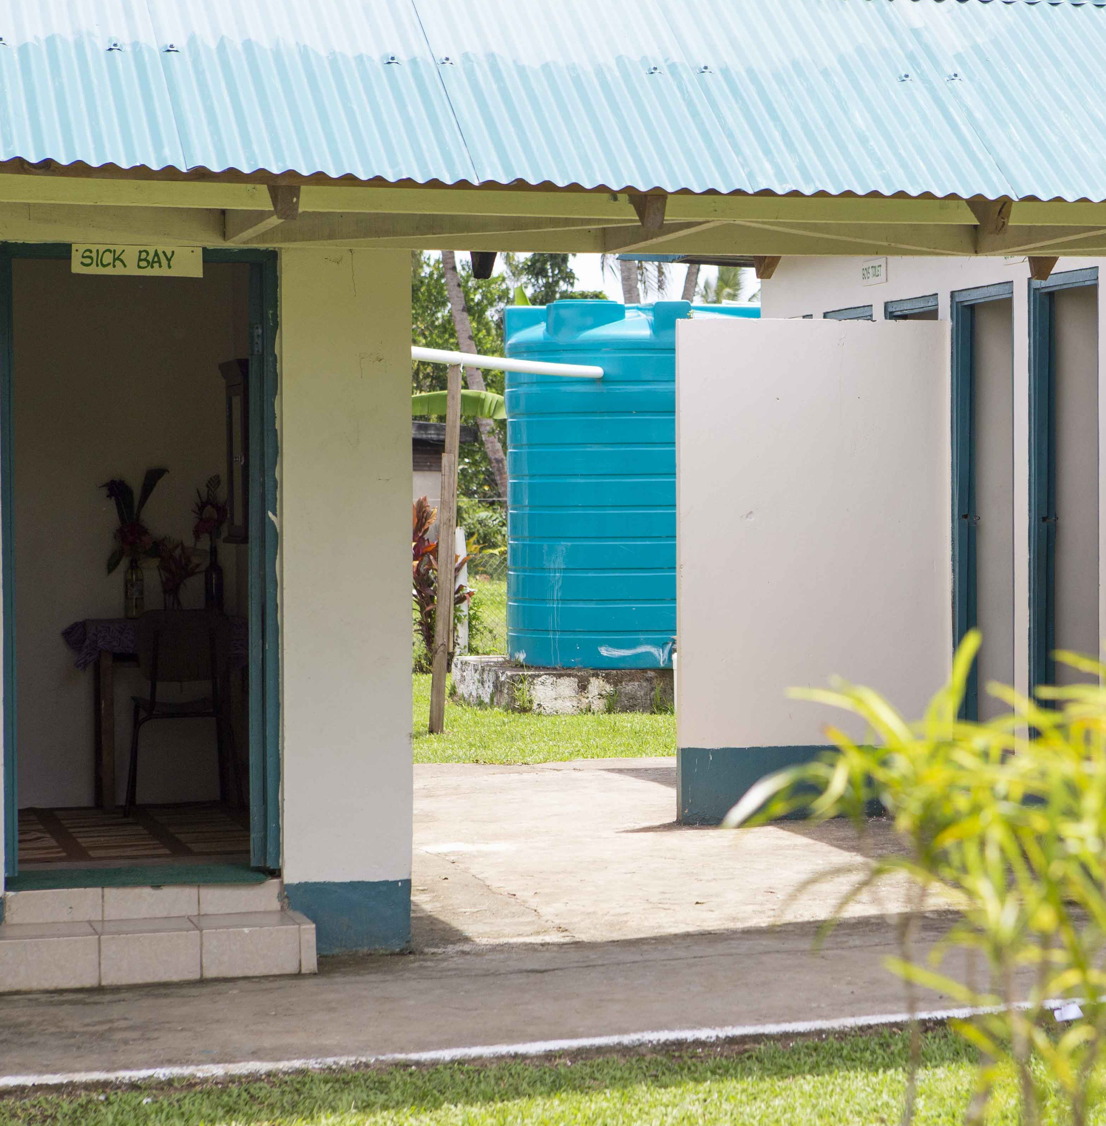
Step 3: Conduct a risk assessment to identify and prioritize areas for improvement
Tasks
1
Start with list of problems found in the facility assessment (step 2).
2
Analysis of associated risks for each problem.
3
Rank problems based on risk and possible impact to prioritize improvements.
Supporting tools: Risk assessment template
Credit: WHO/Will Seal
Notes:
Audio: Step 3 of the WASH FIT Cycle involves conducting a risk assessment, crucial for identifying and prioritizing improvement areas in healthcare facilities. This step begins by generating a comprehensive list of problems taken from the facility assessment (completed in step 2), followed by a detailed analysis of associated risks for each problem. Each problem is ranked based on its potential impact severity, leading to a prioritized list for intervention.

Slide 5
Calculating the risk of each problem
Category | Score | Description
Severity of consequences to facility users and environment | 0–3 = low severity | No significant health impacts are expected, yet enhancements are necessary to meet standards and enhance care quality.
 | 4–6 = medium severity | Moderate adverse health effects, service-related discomfort (e.g., unpleasant odours, unsatisfactory working conditions, potential for minor injuries) and negative impacts on staff morale, performance and the environment are likely.
 | 7–10 = high severity | The issue is highly likely to cause injuries, illness, or infections, hinder essential services, compromise the dignity and safety of facility users, and significantly contaminate the environment, affecting nearby communities.
Likelihood of occurrence | 0–3 = likely to occur only rarely | The problem is likely to occur only rarely.
 | 4–6 = may occur occasionally / half the time | The problem is somewhat likely to occur.
 | 7–10 = highly likely to occur | The issue is persistent, with a very high probability of occurrence.
Notes:
Audio: During the risk assessment process, issues are evaluated based on two criteria, both scored out of 10: severity of consequences and likelihood of occurrence. Severity is categorized into low, medium, and high as shown. This indicates the potential impact on health and the environment.
Likelihood is assessed as rare, occasional, or highly likely, reflecting the frequency of occurrence. By systematically analyzing severity and likelihood, each issue the facility faces is scored out of 20.

Slide 6
Overall risk score
0–7 = low risk
Additional tips
Minimal harm to humans or the environment.
Excel tool will calculate total score automatically.
Avoid tendency to categorize everything as “high risk”.
Alternative risk assessment methods may be developed by team.
8–14 = medium risk
Some harm will occur to humans and/or the environment.
15–20 = high risk
Significant harm is likely to humans and/or the environment.
Notes:
Audio: Low risk issues (scoring less than 7) require minor improvements to meet standards, while medium risk (scoring 8 to 14) may cause discomfort and affect service quality and may require more substantial improvements. High risk problems (scoring 15 to 20) pose significant threats, impacting service provision, compromising safety and affecting dignity and equity. These are the problems that will require immediate attention.
You may wish to develop your own context-appropriate criteria for risk, but make sure that the principles of safeguarding public health are never compromised.
For each problem, the score and the reason behind it should be recorded as a reminder to the team when revisiting the results at a later stage.
This structured approach ensures critical issues are addressed promptly while allowing for the resolution of lower-risk problems over time, optimizing resource allocation.

Slide 7
Overall risk score
0–7 = low risk
Minimal harm to humans or the environment.
Additional tips
Excel tool will calculate total score automatically.
Avoid tendency to categorize everything as “high risk”.
Alternative risk assessment methods may be developed by team.
8–14 = medium risk
Some harm will occur to humans and/or the environment.
15–20 = high risk
Significant harm is likely to humans and/or the environment.
Notes:
Audio: Low risk issues (scoring less than 7) require minor improvements to meet standards, while medium risk (scoring 8 to 14) may cause discomfort and affect service quality and may require more substantial improvements. High risk problems (scoring 15 to 20) pose significant threats, impacting service provision, compromising safety and affecting dignity and equity. These are the problems that will require immediate attention.
You may wish to develop your own context-appropriate criteria for risk, but make sure that the principles of safeguarding public health are never compromised.
For each problem, the score and the reason behind it should be recorded as a reminder to the team when revisiting the results at a later stage.
This structured approach ensures critical issues are addressed promptly while allowing for the resolution of lower-risk problems over time, optimizing resource allocation.

Slide 8
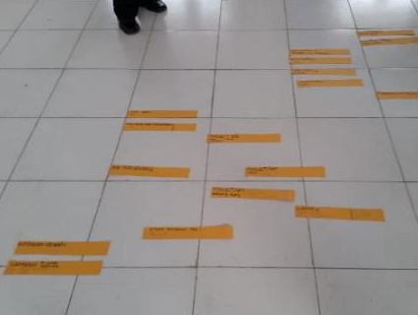
Alternative method used in Indonesia
Staff wrote a list of all problems identified on strips of paper.
Staff ranked these according to risk/priority for addressing them.
Staff collectively prioritized issues through consensus-driven discussions.
Credits: WHO/Arabella Hayter
Notes:
Audio: Let’s look at an example from a small hospital in West Timor, Indonesia. There, a novel approach to prioritizing facility improvements was used. Each indicator that did not meet standards was written on a strip of paper.
Indicators were then sorted by relative risk, without assigning a score. The top third were classified as highest risk and addressed first, the middle third were classified medium risk and the bottom third the lowest risk.
This inclusive approach allowed staff at all levels to engage in the process and contribute to decision-making. They collectively prioritized issues through consensus-driven discussions, using their own criteria tailored to their facility’s needs. It stands out for its simplicity and effectiveness in addressing problems.

Slide 9
Don’t forget - climate change may affect the risk over time
New challenges will arise in the future, each with their own risks.
New risks may exacerbate existing problems.
When calculating the risk score, consider will the risk increase or decrease over time?
Photo: flooding at a HCF in Mozambique after cyclone Idai.
Credit: WHO/Mark Nieuwenhof
Notes:
Audio: The impact of climate change must be considered when assessing risk in healthcare facilities. As our climate changes, it introduces new challenges and exacerbates existing ones, each with its own risks. These risks are dynamic and will evolve over time. Consider how risks might evolve in the future, as they are influenced by climate change. For example, a facility located in a coastal area which faces minimal flood risk now might face increased risk in the future due to rising sea levels.
Integrating climate change into risk assessments will require you to evaluate potential future scenarios based on climate change predictions. This helps anticipate and prepare for evolving threats to increase future resilience. Consulting local or national climate experts may be useful.

Slide 10
How do I use the risk results to prioritize items for action?
Resources are always finite and must be prioritized.
Using risk scores to develop improvement plans helps decision making.
Credit: WHO/Nazik Armenakyan
Notes:
Audio: All health care facilities, whatever the setting, will have finite resources, both financial and human. Facilities need to prioritize where their resources are used.
Using risk scores to develop a facility’s improvement plan helps decision-making. By sorting problems based on severity and likelihood of impact, urgent issues are addressed first, ensuring user safety and operational efficiency.
Some low-risk problems require simple solutions and offer quick-win opportunities. Often the resources required to address the most severe risks are not immediately available. In these instances, it is better to start with the so-called quick wins than to take no action while waiting to address the bigger issues. High-risk issues may need immediate attention, but lower-risk ones should not be overlooked indefinitely.
This strategic approach ensures a balanced allocation of resources, promoting continuous improvement across the facility.

Slide 11
How do I use the risk results to prioritize items for action?
Low-risk problems may require simple solutions and offer quick-win opportunities.
When resources are not available for severe problems, start with quick-wins.
Move on to more severe problems when resources are available.
Ensures better allocation of resources.
Credit: WHO/Nazik Armenakyan
Notes:
Audio: All health care facilities, whatever the setting, will have finite resources, both financial and human. Facilities need to prioritize where their resources are used.
Using risk scores to develop a facility’s improvement plan helps decision-making. By sorting problems based on severity and likelihood of impact, urgent issues are addressed first, ensuring user safety and operational efficiency.
Some low-risk problems require simple solutions and offer quick-win opportunities. Often the resources required to address the most severe risks are not immediately available. In these instances, it is better to start with the so-called quick wins than to take no action while waiting to address the bigger issues. High-risk issues may need immediate attention, but lower-risk ones should not be overlooked indefinitely.
This strategic approach ensures a balanced allocation of resources, promoting continuous improvement across the facility.

Slide 12
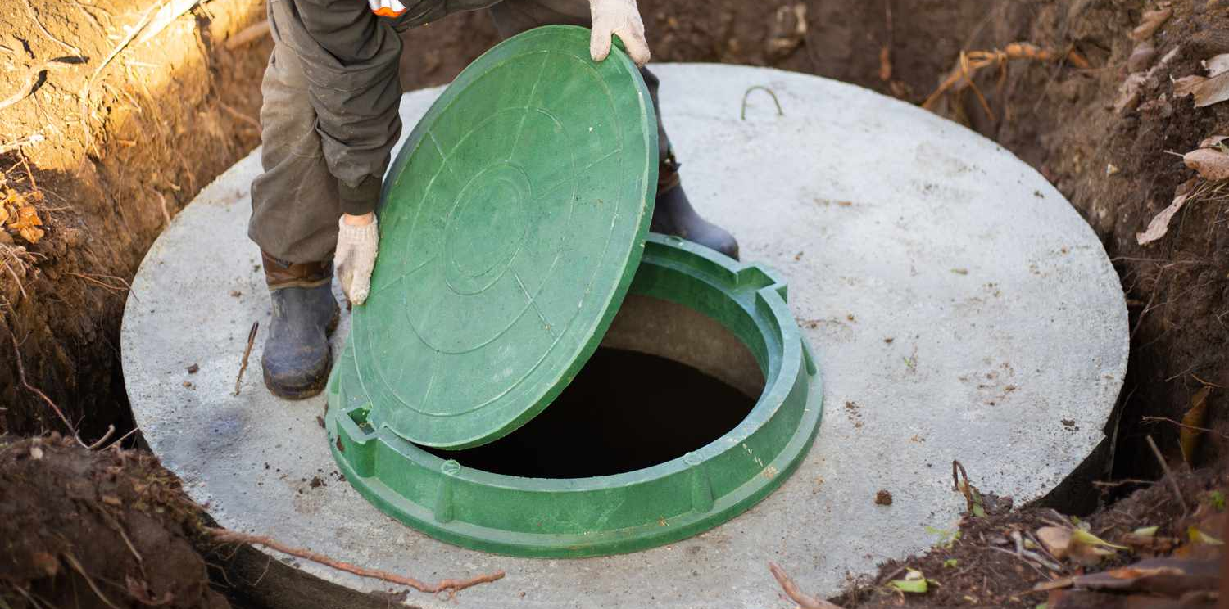
Examples of risk prioritization
Category | Score | Notes
Severity of risk to facility users and environment/climate | 8 | Septic tank overflow contaminates river.
Likelihood of Occurrence | 6 | Septic tank emptying sporadic, budget dependent.
Total score | 14 | Medium risk
Problem to address: Inadequate management of faecal waste
Credit: Alamy Stock Photo/Natalia Kokhanova
Notes:
Audio: We will now look at two examples of risk from one facility. Both of these link to sanitation.
This facility is facing problems with collection of fecal waste so that when heavy rains occur, the tank overflows. The issue depends on many factors including budget, climate fluctuations and the integrity of the structure to begin with.

Slide 13
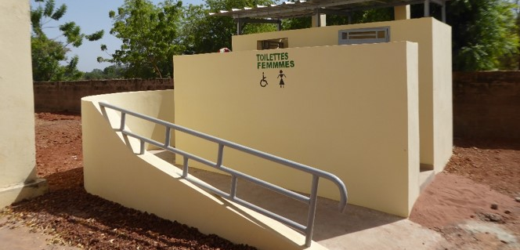
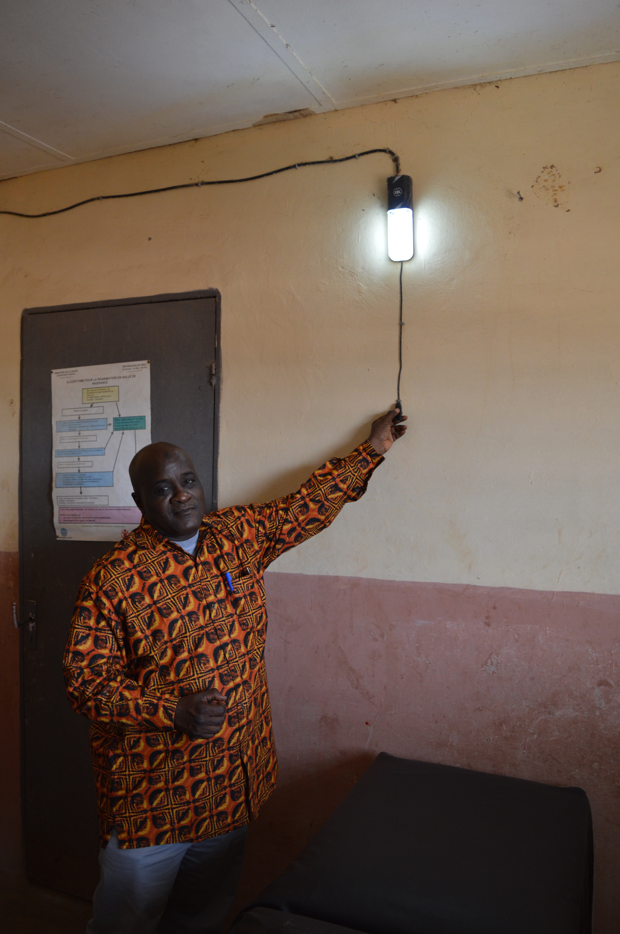
Examples of risk prioritization
Category | Score | Notes
Severity of risk to facility users and environment/climate | 4 | Insufficient lighting poses safety risk.
Likelihood of Occurrence | 3 | Nighttime risks relevant during facility use.
Total score | 7 | Low risk
Problem to be addressed: Lack of lighting in toilets
Credit: WaterAid
Credit: WHO/Arabella Hayter
Notes:
Audio: In this second example, there is a lack of proper lighting in the toilets, light fittings are missing and broken and people using the toilets must carry a torch. There is an issue of safety and risk of falling.

Slide 14
Comparison of risk examples
Faecal waste threat > Lack of lighting in toilets
Momentum builder for tackling bigger issues
Lighting fix = "Quick win”
Notes:
Audio: Based on the risk assessment, the faecal waste problem poses a larger threat than lack of lighting in the toilets, especially if the facility does not usually serve clients at night. However, it may be easier/quicker to fix the lighting, an example of a “quick win”. By fixing this problem, it can build momentum and encourage the facility to tackle more difficult issues, like the safe management of faecal waste. In the next module, we will focus on planning improvements.

Slide 15
Key points
Understand the importance of accurately assigning and interpreting risk scores.
Effectively prioritize actions in areas identified as high risk.
Utilize Excel to streamline the calculation of risk scores.
Formulate strategies for prioritization that are mindful of resource limitations.
Adjust risk management approaches to address environmental challenges.
Credit: WHO/Jin Ni
Notes:
Audio: Thank you for completing this module. Key points to take away:
Understand the importance of accurately assigning and interpreting risk scores.
Effectively prioritize actions in areas identified as high risk.
Utilize Excel to streamline the calculation of risk scores.
Formulate strategies for prioritization that are mindful of resource limitations.
Adjust risk management approaches to address environmental challenges.
Please make sure to explore the reference section of this module for access to all mentioned resources.

