Slide 1
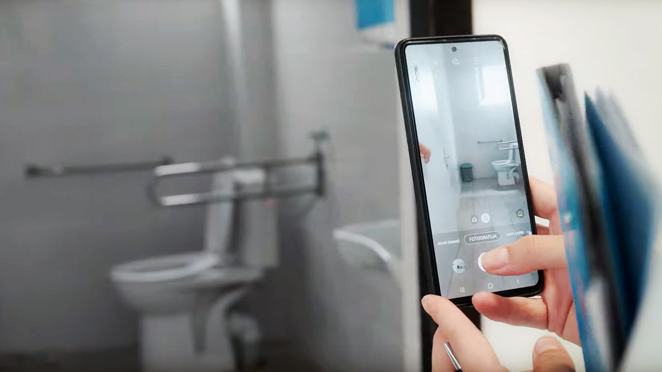
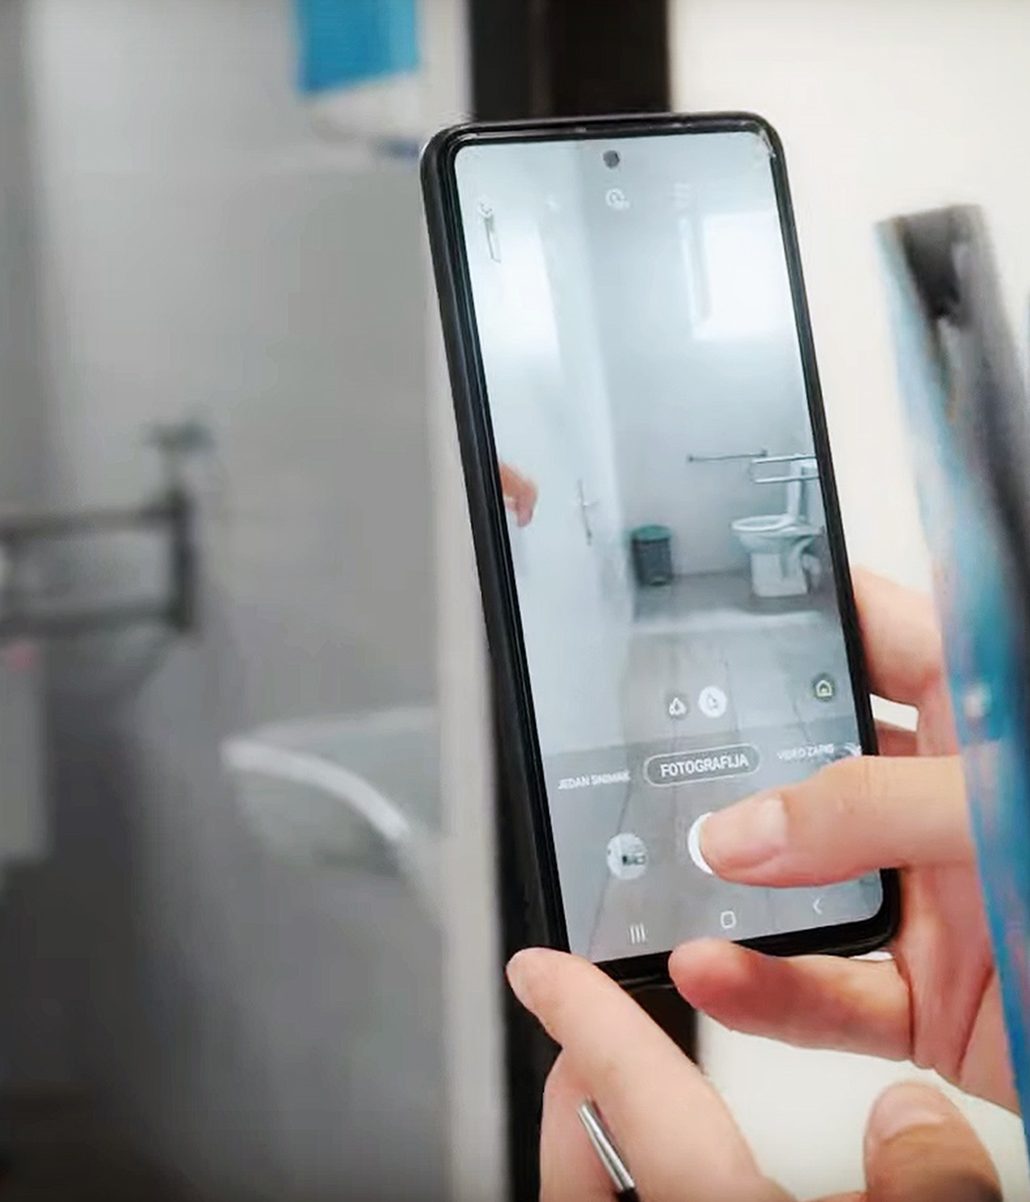
Module 8
Safely managed sanitation in health care facilities
Credit: WHO
Credit: Shutterstock
Notes:
Audio: Welcome back. This is Faustina Gomez from WHO’s South-east Asia Regional Office again. In Module 8, we will explore Safely managed sanitation in health care facilities.​

Slide 2
Learning objectives
By the end of this module, you will:
Understand health care facility minimum sanitation standards.
Learn strategies to combat antimicrobial resistance (AMR).
Explore sanitation technology options.
Learn methods to enhance user-friendliness, gender inclusivity and climate resilience in sanitation facilities.
Notes:
Audio: After completing this module, you'll understand the minimum standards required for sanitation in healthcare facilities. We will look at the interconnections between Antimicrobial Resistance and sanitation, and cover strategies to mitigate this critical issue. We will exploring a range of sanitation technology options and learn methods to enhance user-friendliness, gender inclusivity, and climate resilience in sanitation facilities.

Slide 3
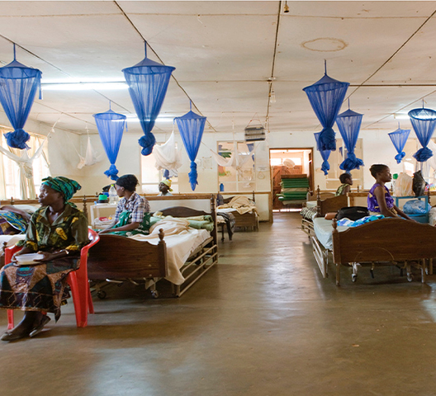
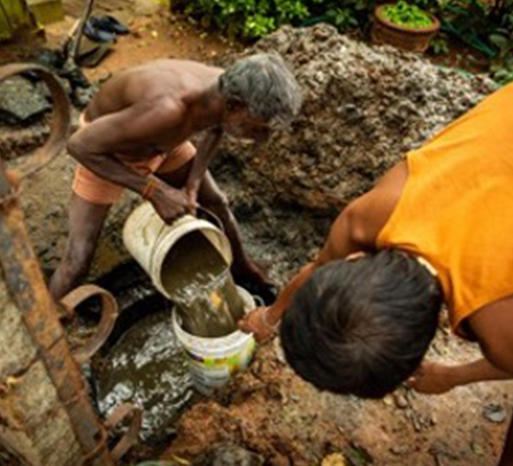
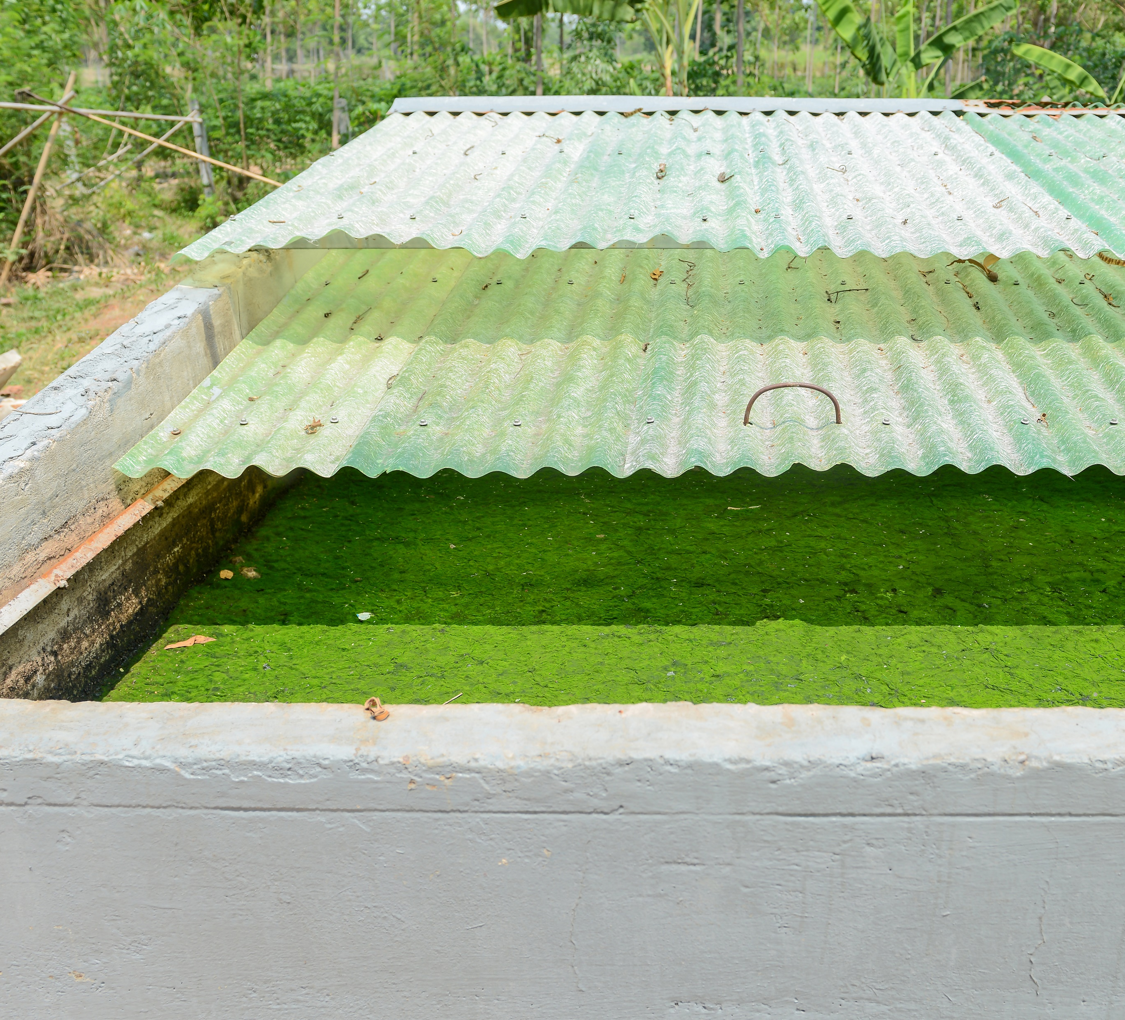
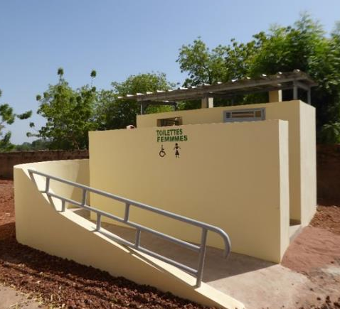
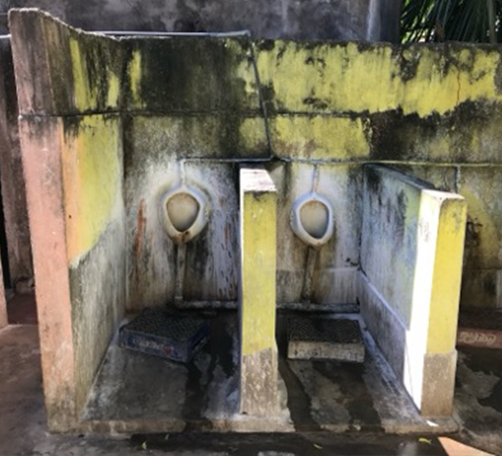
Why is safe sanitation important?
Right to sanitation includes protection against excreta contamination of the environment, crucial in health care facilities.
Wastewater and fecal sludge more likely to carry high concentrations of pathogens, including drug-resistant bacteria.
Lack of sanitation deters women from using health care facilities for childbirth, affecting health and dignity.
Sanitation is a fundamental human right essential for dignity, wellbeing and health.
1 in 10 health care facilities globally lacks sanitation service.
Credit: WaterAid/CS Sharada Prasad, Safai Karmachari, Kavalu Samiti
Credit: Bill and Melinda Gates Foundation
Credit: Shutterstock
Credit: WHO/Walter Owens
Credit: WaterAid
Notes:
Audio: Sanitation is a fundamental human right and central to promoting dignity and wellbeing. Shockingly, however, the latest data published in 2023 by the WHO/UNICEF Joint Monitoring Programme for Water Supply, Sanitation and Hygiene (JMP) reveals that one in ten healthcare facilities worldwide lacks any sanitation service. This not only undermines the health and dignity of staff and patients but also discourages women from delivering in healthcare settings. The right to sanitation extends to protection against the adverse effects of unsanitary conditions, such as the leakage of excreta contaminating the environment, which is of particular concern in healthcare facilities where wastewater and fecal sludge are more likely to carry high concentrations of pathogens, including drug-resistant bacteria.

Slide 4
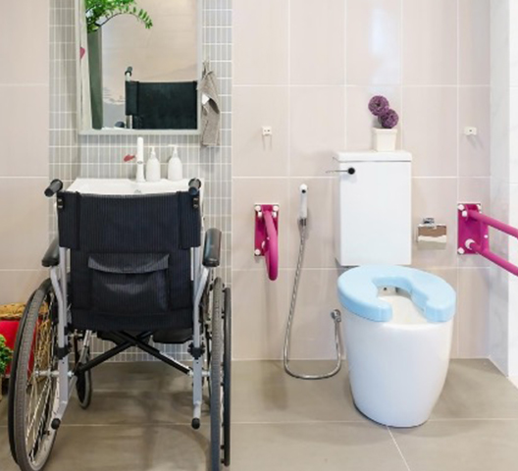
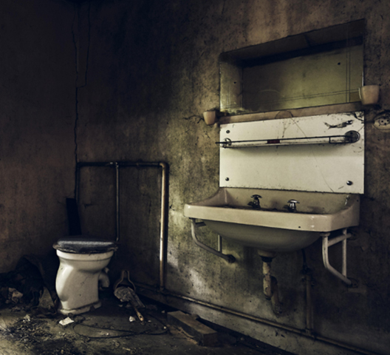
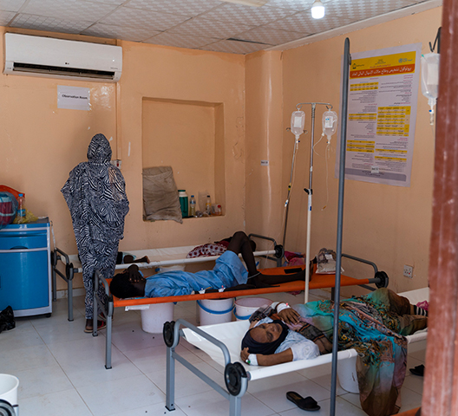
Why is safe sanitation important?
Poor sanitation spreads diseases like cholera, vector-borne diseases (e.g., Lymphatic filariasis, West Nile Virus, malaria, Zika) and neglected tropical diseases (e.g., helminth infections, schistosomiasis).
Sanitation must accommodate users' physical and cultural needs, ensuring accessibility and privacy.
Human feces, containing over a billion pathogens per gram, pose a significant health risk, especially in health care settings.
Credit: freepik.com
Credit: freepik.com
Credit: WHO/Ala Kheir
Notes:
Audio: Sanitation services must cater to the physical and cultural needs of all users. This means accessibility, privacy, and adherence to culturally specific practices of anal cleansing. Human feces, a primary source of microbial pathogens with more than a billion pathogens per gram, pose a significant risk. Diseases such as cholera, which can rapidly spread through the feces of infected individuals, alongside vector-borne diseases like Lymphatic filariasis, West Nile Virus, malaria, Zika, and neglected tropical diseases such as helminth infections and schistosomiasis, underscore the need for improved sanitation to prevent the spread of infectious diseases.​

Slide 5
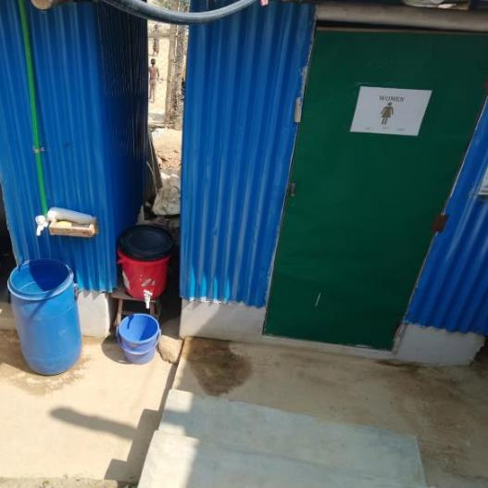
Minimum sanitation requirements
Toilets (latrines)
2
Privacy and lockable door.
No major holes in the structure.
Unblocked hole or pit.
Water available for flush/pour flush toilets.
No cracks or leaks in the structure.
Within facility grounds.
Clean: no waste, visible dirt, excreta, or insects.
3
5
6
4
Separate for male and female or provide privacy (single stall/room) if gender neutral.
1
Support menstrual hygiene management needs.
Have a functioning hand washing station within 5m.
At least one facility for people with limited mobility.
Onsite, accessible & usable.
Gender segregated toilet with hand washing station in Cox’s Bazaar, Bangladesh.
Credit: Miriam Klinkenberg
Notes:
Audio: So what are the minimum requirements for sanitation in a health care facility? Toilets should be onsite, accessible and usable. They should offer privacy, having a door that is unlocked when not in use (or for which a key is available) and can be locked from the inside during use. There should be no major holes in the structure, the hole or pit should not be blocked, water should be available for flush/pour flush toilets, and there should be no cracks or leaks in the toilet structure. It should be within the grounds of the facility and clean, as noted by the absence of waste, visible dirt, excreta, and insects. Facilities should be gender-separated or provide privacy if gender neutral, include options for limited mobility, and support menstrual hygiene management needs. Toilets should have handwashing stations with water and soap, rather than alcohol-based hand rub, which does not remove fecal matter from hands.

Slide 6
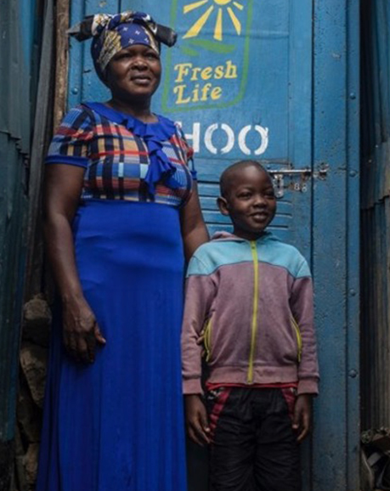
How many toilets and showers are required?
Toilets
Inpatients: 1 per 20 users
Outpatients:
Minimum: 2 (1 for staff and 1 for patients),
For bigger facilities: 4 (male/female staff & male/female patients; one should be accessible to those with limited mobility).
Showers
Inpatients: 1 per 40 users
And shower available in the labour and delivery area.
Credit: UNICEF/Modola
Notes:
Audio: How many toilets and showers are required in health care facilities? The minimum number of facilities is 2, which is considered realistic even for very small healthcare facilities. For larger facilities, more toilets should be available. For inpatients, there should be 1 toilet per 20 users. For outpatients, a minimum of 2 toilets is required (1 for staff and 1 for patients). Ideally and where possible, there should be 4 (2 for staff, separated by gender and 2 for patients separated by gender). At least one should be accessible to those with limited mobility.

Slide 7
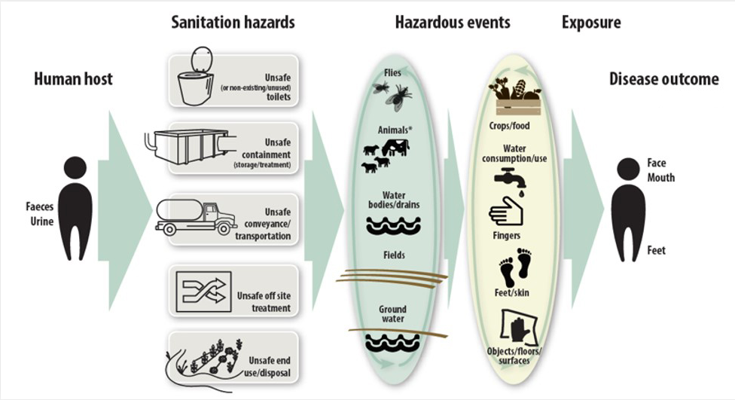
Transmission of excreta-related pathogens: the ‘F-Diagram’
Notes:
Audio: Sanitation is a crucial barrier against the transmission of pathogens associated with excreta. This is the Faecal-Diagram, also known as an F-diagram, which clearly shows faecal-oral disease transmission routes. It illustrates how failure at any point along the sanitation chain can lead to disease transmission. Faeces which are not disposed or stored safely represent a health risk for humans, since pathogens in faeces can be transmitted to humans by flies, contaminated foods, unwashed hands, and through crops and fluids, including water. Unsafe sanitation leads to infections, developmental issues, and broader well-being impacts; for a detailed list of outcomes, see Table 1.1 in WHO's Guidelines on Sanitation and Health.

Slide 8
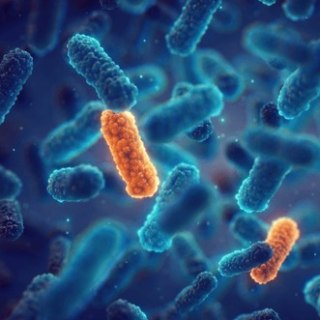
How can sanitation curb the spread of antimicrobial resistance (AMR)?
AMR occurs when bacteria, viruses, fungi and parasites no longer respond to antimicrobial medicines.
Antimicrobials (antibiotics, antivirals, antifungals, antiparasitics).
Credit: Shutterstock
Increases the risk of disease spread, severe illness, disability and death.
Notes:
Audio: Antimicrobials – including antibiotics, antivirals, antifungals, and antiparasitics – are medicines used to prevent and treat infectious diseases in humans, animals and plants. Antimicrobial Resistance, or AMR, occurs when bacteria, viruses, fungi and parasites no longer respond to antimicrobial medicines. As a result of drug resistance, antibiotics and other antimicrobial medicines become ineffective and infections become difficult or impossible to treat, increasing the risk of disease spread, severe illness, disability and death.
Inadequate access to sanitation in health care facilities can increase the risk of AMR. Wastewater originating from healthcare facilities often contains elevated levels of resistant bacteria and residues from antimicrobials, including those considered last-line defenses. So what can be done?
The priority should be the safe collection, storage, and treatment of wastewater and sludge, either on-site or off-site.
Treatment systems must effectively remove AMR-resistant bacteria at rates comparable to other bacteria, thus reducing the risk of transmission through wastewater and sludge. Secondary treatment is generally considered sufficient but higher levels of treatment may provide additional protection.
In addition to safe sanitation, facilities should also implement drinking water treatment methods such as filtration or chlorination to reduce waterborne diarrhoea, thereby minimizing the need for antibiotics due to waterborne illnesses.
And finally, practice stringent infection prevention and control measures, including thorough hand hygiene protocols.
To learn more about AMR in health care facilities, take the OpenWHO course “Antimicrobial Resistance (AMR) in the Environment: Key Concepts and Interventions”.

Slide 9
How can sanitation curb the spread of antimicrobial resistance (AMR)?
Inadequate access to sanitation can increase the risk of AMR.
Prioritise safe collection, storage, treatment of wastewater and sludge.
Humans excrete up to 80% of antimicrobials after ingestion, as well as resistant microbes and genes. All of this ends up in wastewater.
Effective treatment systems (e.g., at least secondary) remove AMR-resistant bacteria at similar rates as other bacteria.
Credit: Shutterstock
Notes:
Audio: Antimicrobials – including antibiotics, antivirals, antifungals, and antiparasitics – are medicines used to prevent and treat infectious diseases in humans, animals and plants. Antimicrobial Resistance, or AMR, occurs when bacteria, viruses, fungi and parasites no longer respond to antimicrobial medicines. As a result of drug resistance, antibiotics and other antimicrobial medicines become ineffective and infections become difficult or impossible to treat, increasing the risk of disease spread, severe illness, disability and death.
Inadequate access to sanitation in health care facilities can increase the risk of AMR. Wastewater originating from healthcare facilities often contains elevated levels of resistant bacteria and residues from antimicrobials, including those considered last-line defenses. So what can be done?
The priority should be the safe collection, storage, and treatment of wastewater and sludge, either on-site or off-site.
Treatment systems must effectively remove AMR-resistant bacteria at rates comparable to other bacteria, thus reducing the risk of transmission through wastewater and sludge. Secondary treatment is generally considered sufficient but higher levels of treatment may provide additional protection.
In addition to safe sanitation, facilities should also implement drinking water treatment methods such as filtration or chlorination to reduce waterborne diarrhoea, thereby minimizing the need for antibiotics due to waterborne illnesses.
And finally, practice stringent infection prevention and control measures, including thorough hand hygiene protocols.
To learn more about AMR in health care facilities, take the OpenWHO course “Antimicrobial Resistance (AMR) in the Environment: Key Concepts and Interventions”.

Slide 10
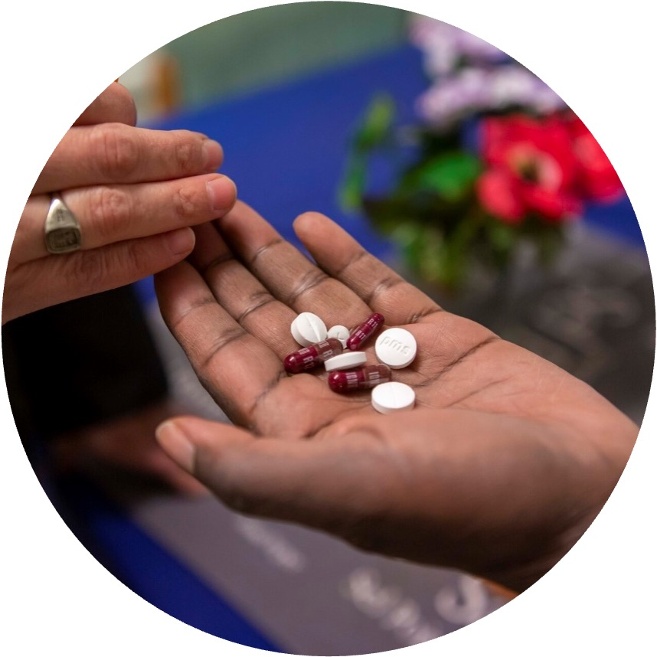
How can sanitation curb the spread of antimicrobial resistance (AMR)?
Other measures:
Drinking water treatment (e.g., filtration or chlorination) reduces waterborne diarrhoea and need for antibiotics.
IPC measures including hand hygiene limit spread.
Credit: WHO/Christine McNab
Notes:
Audio: Antimicrobials – including antibiotics, antivirals, antifungals, and antiparasitics – are medicines used to prevent and treat infectious diseases in humans, animals and plants. Antimicrobial Resistance, or AMR, occurs when bacteria, viruses, fungi and parasites no longer respond to antimicrobial medicines. As a result of drug resistance, antibiotics and other antimicrobial medicines become ineffective and infections become difficult or impossible to treat, increasing the risk of disease spread, severe illness, disability and death.
Inadequate access to sanitation in health care facilities can increase the risk of AMR. Wastewater originating from healthcare facilities often contains elevated levels of resistant bacteria and residues from antimicrobials, including those considered last-line defenses. So what can be done?
The priority should be the safe collection, storage, and treatment of wastewater and sludge, either on-site or off-site.
Treatment systems must effectively remove AMR-resistant bacteria at rates comparable to other bacteria, thus reducing the risk of transmission through wastewater and sludge. Secondary treatment is generally considered sufficient but higher levels of treatment may provide additional protection.
In addition to safe sanitation, facilities should also implement drinking water treatment methods such as filtration or chlorination to reduce waterborne diarrhoea, thereby minimizing the need for antibiotics due to waterborne illnesses.
And finally, practice stringent infection prevention and control measures, including thorough hand hygiene protocols.
To learn more about AMR in health care facilities, take the OpenWHO course “Antimicrobial Resistance (AMR) in the Environment: Key Concepts and Interventions”.

Slide 11
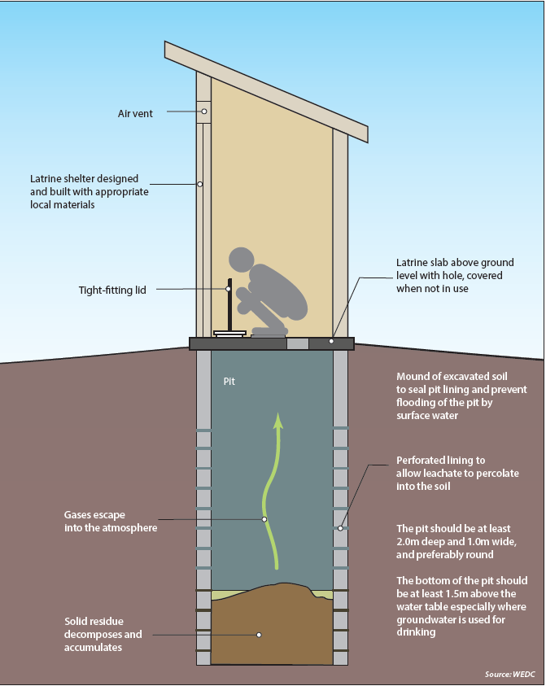
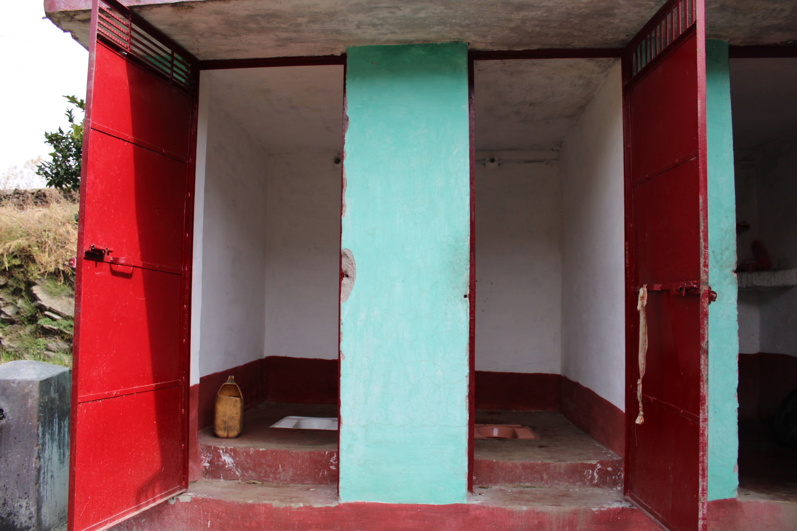
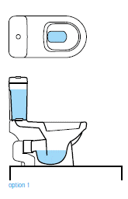
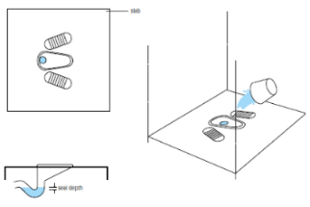
Toilet options
Water availability.
Waste management.
Personal hygiene practices.
Accessible and affordable to all.
Durability, hygiene.
Protection from stormwater.
Safety and usability.
Pour flush or cistern toilets
Dry (no flush) toilet
Credit: Shutterstock
Notes:
Audio: We will now look at some sanitation technologies, starting with toilets and moving on to on-site and off-site treatment options. Toilet designs must match local conditions, including water availability, waste management, and personal hygiene practices, while being accessible and affordable to all. Features should ensure durability, hygiene, and protection from stormwater. Safety and usability enhancements may include sex-separated facilities, locks, lighting, and disability access. Pour flush toilet devices are readily available and their use is encouraged where any source of water.
Biogas reactors offer waste treatment with energy recovery but require regular maintenance and a market for the gas.

Slide 12
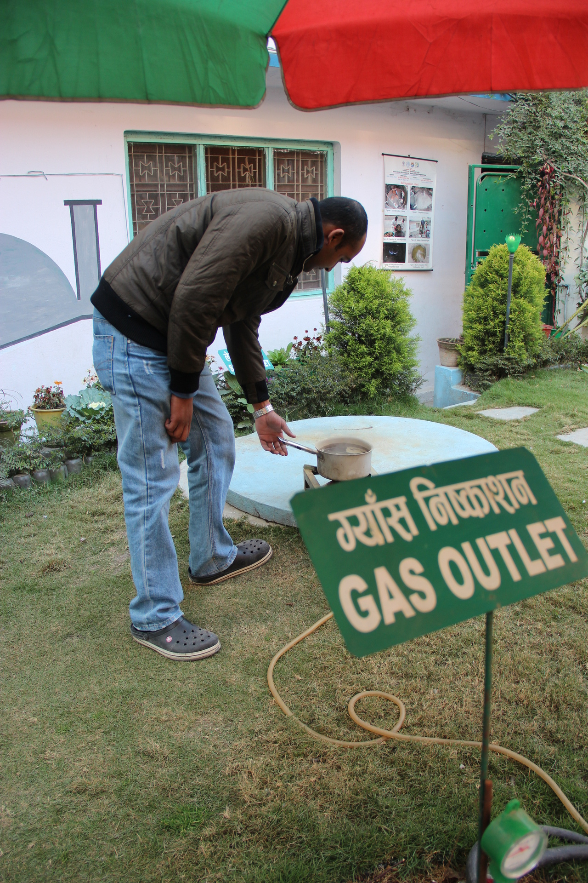
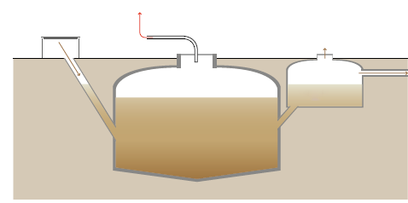
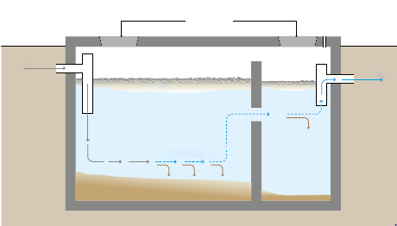
Toilet options
fly screen
inlet
biogas pipe
> 11 cm vent pipe
access cover
biogas
outlet
digestate
expansion chamber
Slurry
access covers
vent
inlet
inlet-T
outlet
scum
sedimentation zone
sludge
Credit: WHO/Vismita Gupta-Smith
Bio-gas reactor or septic tank
Notes:
Audio: We will now look at some sanitation technologies, starting with toilets and moving on to on-site and off-site treatment options. Toilet designs must match local conditions, including water availability, waste management, and personal hygiene practices, while being accessible and affordable to all. Features should ensure durability, hygiene, and protection from stormwater. Safety and usability enhancements may include sex-separated facilities, locks, lighting, and disability access. Pour flush toilet devices are readily available and their use is encouraged where any source of water.​
Biogas reactors offer waste treatment with energy recovery but require regular maintenance and a market for the gas.​

Slide 13
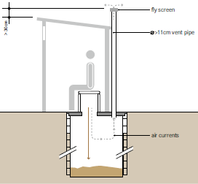
On-site treatment options (with periodic emptying and disposal on or off-site)
fly screen
> 30 cm
> 11 cm vent pipe
Collection, storage and treatment of excreta (referred to as fecal sludge) directly on the plot where they are generated.
Onsite system
Offsite system
air currents
Single, ventilated pit latrine
Notes:
Audio: Sanitation systems can be broadly categorized into onsite and offsite systems. Onsite treatment involves the collection, storage, and treatment of excreta (referred to as faecal sludge) directly on the plot where they are generated. ​
​
In rural primary care facilities with ample space, few patients, and limited resources, a single, ventilated pit latrine may be the most suitable option. The latrine must be upgradient and at a safe distance over 15 meters from any water source. Once the pit is filled, it must be safely emptied and the waste should be taken offsite for further treatment or covered, and a new pit should be dug.

Slide 14
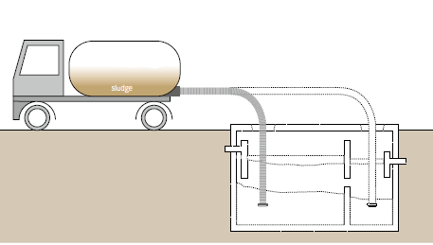
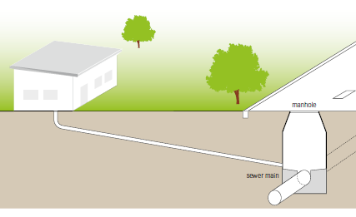
Off-site options (or on-site treatment for large health care facilities)
Motorized collection
Gravity sewer
Notes:
Audio: Off-site sanitation involves collecting and transporting excreta, or wastewater, away from its source. This is often done through sewer technologies, utilizing manual or motorized methods for removing faecal sludge from facilities. Motorized transport, using vehicles with pumps and storage tanks, is common for wet systems like septic tanks. However, access to toilets can be challenging, especially in urban areas. Sewer-based systems, including gravity, simplified, and solids-free sewers, transport waste to treatment facilities. While gravity sewers are prevalent in high-income countries, low and middle-income countries often lack adequate sewage infrastructure. Health care facility managers and the WASH FIT team can advocate for improved sewage systems. Alternative treatment options include waste stabilization ponds for warm climates and anaerobic filters for more sophisticated treatment. Further details on off-site sanitation options are available in the module resources.
With all these technologies, sanitation workers face high risks, often working in confined and hazardous environments where they encounter infectious diseases and harmful chemicals. Safety measures, rigorous protocols, training, and appropriate protective gear are essential to mitigate these risks.

Slide 15
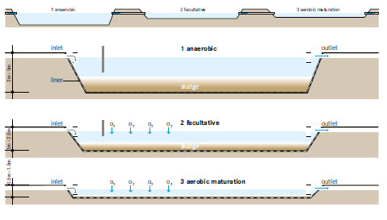
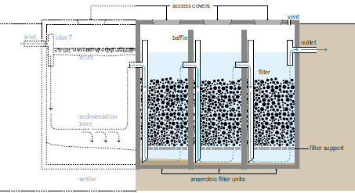
Off-site options (or on-site treatment for large health care facilities)
Motorized collection
Waste stabilization pond
Gravity sewer
Anaerobic filter
Notes:
Audio: Off-site sanitation involves collecting and transporting excreta, or wastewater, away from its source. This is often done through sewer technologies, utilizing manual or motorized methods for removing faecal sludge from facilities. Motorized transport, using vehicles with pumps and storage tanks, is common for wet systems like septic tanks. However, access to toilets can be challenging, especially in urban areas. Sewer-based systems, including gravity, simplified, and solids-free sewers, transport waste to treatment facilities. While gravity sewers are prevalent in high-income countries, low and middle-income countries often lack adequate sewage infrastructure. Health care facility managers and the WASH FIT team can advocate for improved sewage systems. Alternative treatment options include waste stabilization ponds for warm climates and anaerobic filters for more sophisticated treatment. Further details on off-site sanitation options are available in the module resources.
With all these technologies, sanitation workers face high risks, often working in confined and hazardous environments where they encounter infectious diseases and harmful chemicals. Safety measures, rigorous protocols, training, and appropriate protective gear are essential to mitigate these risks.

Slide 16
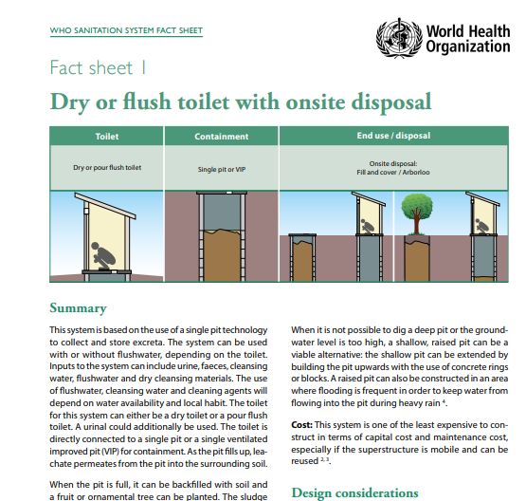
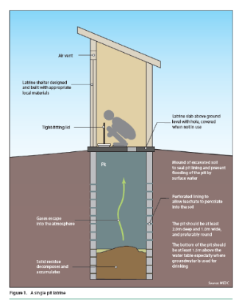
Sanitation system fact sheets and inspection forms
7 most common types of sanitation designs.
Identify main risks and appropriate remedial actions.
Applicability.
Design considerations.
Operation and maintenance.
Measures to protect public health.
Can be used as part of routine WASH FIT assessments.
Notes:
Audio: The WHO Guidelines on Sanitation and health include 11 sanitation system fact sheets and inspection forms. These are short, standardized observation checklists that can be used to assess risk factors at or near sanitation facilities and identify appropriate remedial actions to safeguard public health.
The fact sheets cover applicability, design considerations, operation and maintenance, and measures to protect public health. They are accompanied by sanitary inspection forms and management advice sheets. They can be used as part of routine WASH FIT assessments for those that want to look at sanitation systems in more detail.

Slide 17
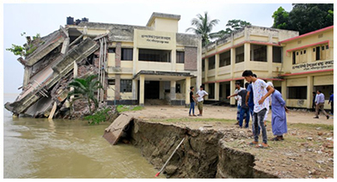
What are three main climate impacts on sanitation?
Credit: Alamy Stock/M Rahman
Credit: WHO
Credit: WHO
More intense precipitation or inundation caused by sea-level rise
Long-term declines in rainfall and run-off
Higher temperatures & heatwaves
(long-term drought, etc.)
(warmer surface water & soil temperatures)
(extreme rainfall events, floods, landslides, etc.)
Impedes function of water-reliant sanitation systems.
Malfunction, breakdown or inaccessibility of sanitation systems.
Flooding of on-site systems
E.g., flush toilets, sewerage
Destruction of facilities
Spillage
Overflow
Environmental contamination
Strong odours during heatwaves deter use of latrines.
Notes:
Audio: We will now look at the impact of climate change on sanitation. Pause the video and take a minute to look at the pictures and consider what the impact could be on sanitation systems.
Climate impacts on sanitation are varied and severe. Intense weather events, including heavy rainfall, floods, and landslides, often lead to the destruction of sanitation facilities, spilling and overflowing of waste, resulting in significant environmental contamination. Persistent droughts cause a decline in water availability, affecting the functionality of water-dependent sanitation systems like flush toilets. High temperatures and heatwaves exacerbate these issues, leading to the malfunction of sanitation systems and increasing odors, which deter use. Climate-resilient sanitation infrastructure is more important than ever.

Slide 18
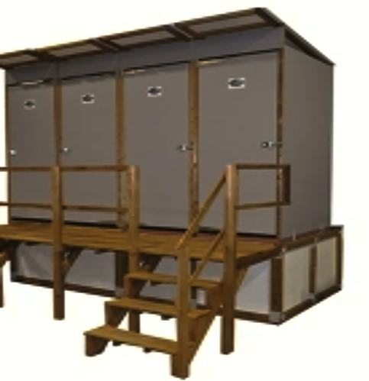
Improving climate resilience of sanitation technologies
Locate toilets in flood-resistant, stable locations.
Place open pit/soak-away toilets >15m from water sources, >1.5m above the water table.
Use raised/temporary toilets with regular emptying.
Opt for low-water or waterless toilets in water-scarce or flood-prone areas.
Increase cleaning frequency with higher demand or during outbreaks.
Credit: WHO
Notes:
Audio: So what can you do to improve resiliency? Locate toilets away from flood-prone or erosion-prone areas, at least 15 meters from water sources, and above the water table to prevent contamination. In disaster-prone regions, chose raised or enclosed toilets that are easily emptied. In water-scarce or flood-prone areas, opt for low-water or waterless toilet systems like urine-diverting dry toilets.
Empty septic tanks before flood-prone seasons to prevent overflow and restrict access to flood-exposed areas. Finally, maintain hygiene standards through regular, more frequent cleaning, during periods of heightened risk like cholera outbreaks.

Slide 19
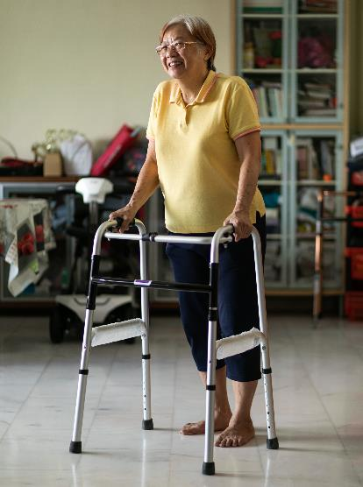
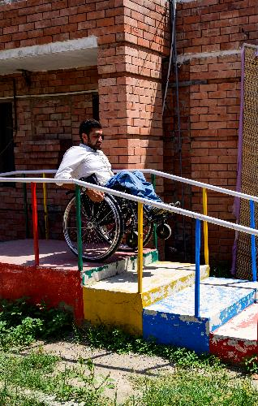
Accessing sanitation services is a challenge for many
Common problems include:
Lack of privacy and safety for women and girls.
Squat toilets + no handrails inaccessible for those with mobility issues.
Insufficient space in toilets to move around.
Pathways to toilets difficult to use for people with limited mobility, such as wheelchair users.
Credit: WHO/Juliana Tan
Credit: WHO/Sebastian Liste
Notes:
Audio: Sanitation services pose unique challenges for children, older people, pregnant women and women in labour, individuals with disabilities, post-surgery patients, women and girls, and indigenous communities. Common issues arise from the design and location of facilities. Four examples are presented here. Take a moment to think – have you ever faced problems accessing sanitation facilities? How did this make you feel?
You can refer to the WASH FIT indicators for further guidance on improving accessibility of toilets, including specifications of toilets, access paths, measurements for sinks, taps, doors and hand washing stations that accommodate wheelchair users and those with disabilities. More information on accessibility is provided in the GEDSI module of this course.

Slide 20
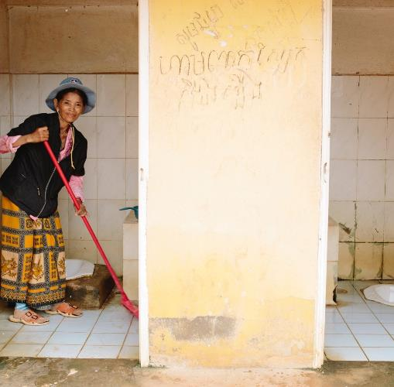
Cleaning and maintaining sanitation facilities
Regular spot checks (establish process for rapidly addressing dirty or broken toilets).
Clean toilets daily.
Provision of personal protective equipment to cleaning staff.
Assign and train teams for ongoing facility upkeep.
Ensure toilet side sprays are cleaned or removed post-use.
Regularly restock and replace toiletries and cleaning supplies.
Credit: WaterAid/Tom Greenwood
Notes:
Audio: Unclean toilets and bathrooms pose significant health risks, inviting disease-causing organisms and deterring proper use. Regular spot checks, cleaning and provision of personal protective equipment to cleaning staff will help keep toilets clean. We will go into more details on cleaning requirements in module 11.
Toilet side sprays (a popular feature in many cultures) should be removed or thoroughly cleaned after every use. Side sprays are an obvious source of person-to-person fecal contamination, as discussed previously in this module.
Essential hygiene products like anal cleansing materials and soap for handwashing should be regularly replenished. For dry toilets, ensure a ready supply of materials like ash or sawdust for covering feces, preventing flies and odors.

Slide 21
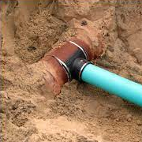
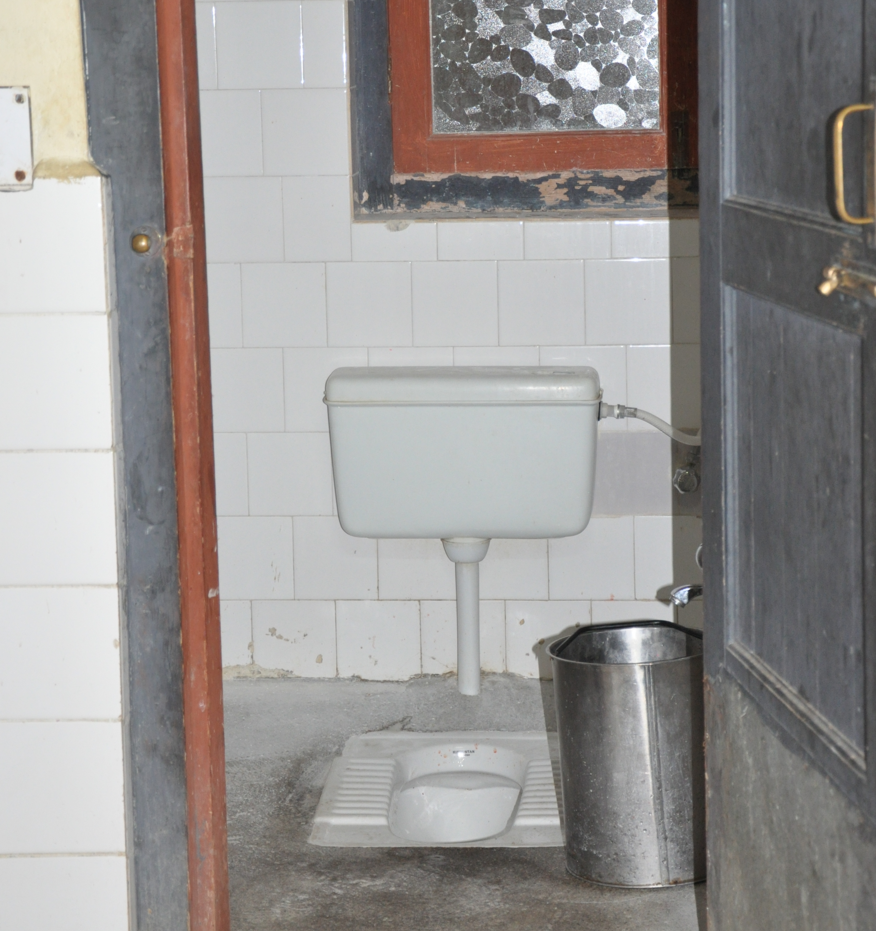
Maintaining plumbing to support safer sanitation systems
Clean toilet with functioning flush in Bhutan
Septic system
Conduct periodic emptying of sludge.
Prevent pooling water – no discharge to open ground or open drains.
Functioning sewer connection
Credits: WHO/Arabella Hayter
Notes:
Audio: Plumbing is needed to maintain sanitation systems, especially septic systems. Specific plumbing tasks include regularly emptying sludge to ensure efficient operation, preventing pooling water and avoiding discharge to open ground or drains to safeguard environmental health.
There should also be adequate setback distances from on-site water sources and appropriate sewer connections to prevent contamination. It's crucial to check for leaks and overflows, ensuring that solids and liquids are conveyed to treatment facilities or sewers without compromising hygiene.
Discussions with authorities and downstream assessments will be necessary to confirm that sewers lead to safely managed treatment plants, preventing septic effluent from flowing into community drains or water sources. These measures ensure the effective functioning of septic systems, minimizing health risks and promoting environmental sustainability in sanitation practices.
The technical factsheet on safe plumbing for WASH services provides some examples of suggested plumbing improvements and plumbing considerations throughout the WASH FIT cycle.

Slide 22
Maintaining plumbing to support safer sanitation systems
Clean toilet with functioning flush in Bhutan
Sewer connections
Adequate setback distance from on-site water sources.
Confirm sewer conveys solids and liquids with minimal leaks/overflows to treatment facility or sewer.
Functioning sewer connection
Credits: WHO/Arabella Hayter
Notes:
Audio: Plumbing is needed to maintain sanitation systems, especially septic systems. Specific plumbing tasks include regularly emptying sludge to ensure efficient operation, preventing pooling water and avoiding discharge to open ground or drains to safeguard environmental health.
There should also be adequate setback distances from on-site water sources and appropriate sewer connections to prevent contamination. It's crucial to check for leaks and overflows, ensuring that solids and liquids are conveyed to treatment facilities or sewers without compromising hygiene.
Discussions with authorities and downstream assessments will be necessary to confirm that sewers lead to safely managed treatment plants, preventing septic effluent from flowing into community drains or water sources. These measures ensure the effective functioning of septic systems, minimizing health risks and promoting environmental sustainability in sanitation practices.
The technical factsheet on safe plumbing for WASH services provides some examples of suggested plumbing improvements and plumbing considerations throughout the WASH FIT cycle.

Slide 23
Maintaining plumbing to support safer sanitation systems
Soakage pits/septic effluent
Clean toilet with functioning flush in Bhutan
Check with authorities to see if the sewer goes to a safely managed treatment plant.
Functioning sewer connection
Credits: WHO/Arabella Hayter
Notes:
Audio: Plumbing is needed to maintain sanitation systems, especially septic systems. Specific plumbing tasks include regularly emptying sludge to ensure efficient operation, preventing pooling water and avoiding discharge to open ground or drains to safeguard environmental health.
There should also be adequate setback distances from on-site water sources and appropriate sewer connections to prevent contamination. It's crucial to check for leaks and overflows, ensuring that solids and liquids are conveyed to treatment facilities or sewers without compromising hygiene.
Discussions with authorities and downstream assessments will be necessary to confirm that sewers lead to safely managed treatment plants, preventing septic effluent from flowing into community drains or water sources. These measures ensure the effective functioning of septic systems, minimizing health risks and promoting environmental sustainability in sanitation practices.
The technical factsheet on safe plumbing for WASH services provides some examples of suggested plumbing improvements and plumbing considerations throughout the WASH FIT cycle.

Slide 24
Key points
Ensure sanitation facilities are accessible, hygienic and dignified for all.
Go beyond clean toilets: manage fecal waste safely from collection to disposal.
Prioritize regular toilet maintenance for effective risk management.
Combat AMR with well-managed sanitation and proper pharmaceutical disposal.
Credit: WHO
Notes:
Audio: Thank you for completing this module. Here are the key points:​
​
Sanitation facilities must be accessible to all, prevent infection spread, and uphold every user's dignity and wellbeing.​
A clean, operational toilet is crucial, but it's equally important to ensure fecal waste is safely collected, transported, treated, and disposed of.​
Regularly cleaning and maintaining toilet facilities is a cost-effective way to mitigate risks associated with fecal waste.​
The spread of Antimicrobial Resistance can be curtailed through well-managed sanitation systems and the safe disposal of pharmaceuticals, without the need for expensive, high-tech solutions.​
​
Please refer to the reference section of this module to access links to all mentioned resources.

