Slide 1
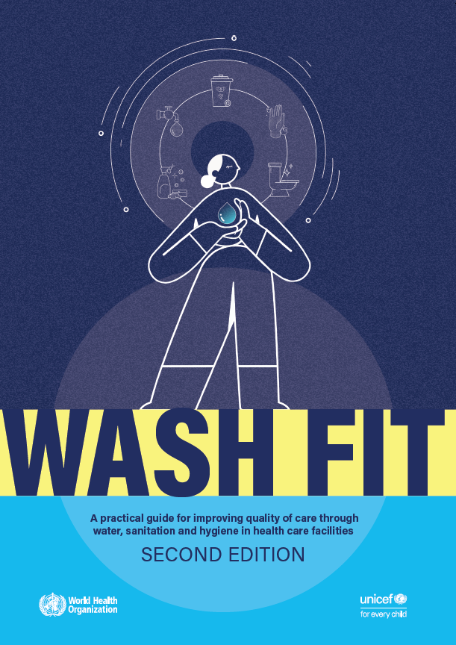
WASH FIT
2026 meet up series
Session 2: Health care waste management
27th May 2026

Slide 2
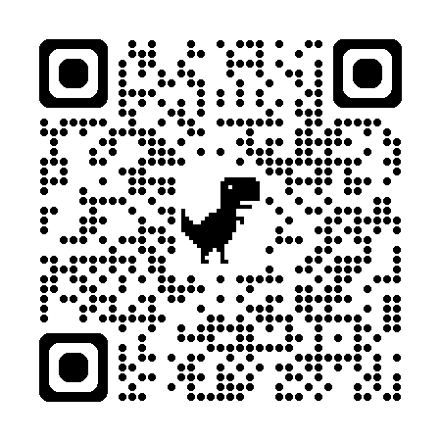
2026 meet up series
Feb. | Water quality management Introduction to new Water safety planning quick guide Country experiences from Ukraine and Bangladesh | Watch the recording here:
July | Plumbing for health Considerations for plumbing in high income settings Country experiences | World Plumbing Council/IAPMO
Sept. | Emergencies Application of WASH FIT in emergency settings Integration of IPCAF and WASH FIT in DRC | IRC Democratic Republic of Congo

Slide 3
Agenda
Introduction to water quality in health care facilities
Ute Pieper, WHO
Use of WASH FIT to support safe health care waste management in Fiji
Luke Vonotabua, Ministry of Health and Medical Services, Fiji
Sneak peak! New WHO Academy waste management course
Dave Trouba, WHO
Questions and answer
Moderator: Ranjit Dhiman, UNICEF
Slides will be added to www.washinhcf.org/resources and the recording to the WASH in HCF YouTube channel

Slide 4
What’s new?
Safe and sustainable health care health waste management
Ute Pieper & Maggie Montgomery, WHO

Slide 5
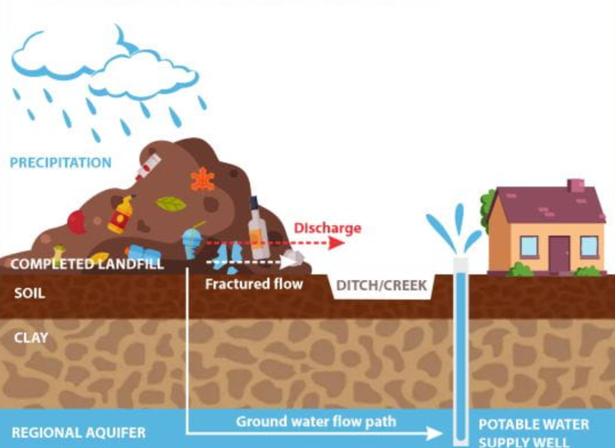
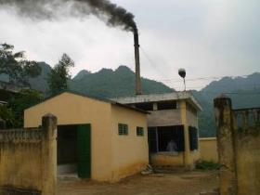
Environmental and human health impact from health care waste substantial and growing
Greenhouse gases: Methane / CO₂
POPs: Dioxins and furans
Soil and water:
Microplastic
Heavy metals (e.g. mercury)
Toxic organics
Antimicrobials
Radioactive materials…
Soil and water pollution
Notes:
Methane emissions from landfills: Methane is a potent greenhouse gas at least 28 times more effective than CO₂ at trapping heat in the atmosphere over a 100-year period
Dioxins and furans: Once released, dioxins and furans settle in soil and water bodies, affecting wildlife and ecosystems. D&F persist in the environment for decades, accumulating in the fatty tissues of animals and moving up the food chain.

Slide 6
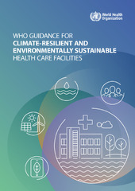
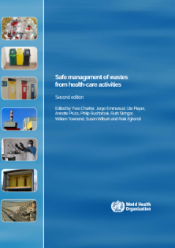
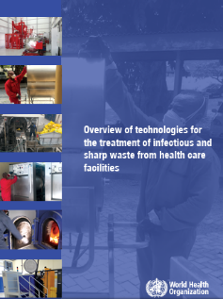
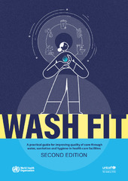
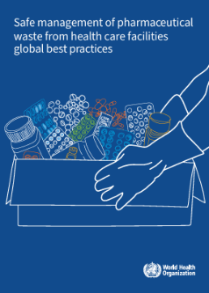
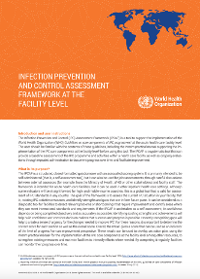
WHO guidance and tools to support safe and sustainable waste management
Guidance
  Comprehensive (2014)
  Pharmaceutical waste (2025)
  Climate resilient and environmentally sustainable HCFs (2020)
  Treatment technologies (2019)
Open Access WHO Academy Courses
  WASH FIT (2024)
  Advanced Health Care Waste (June 2026)
Tools/training
  WASH FIT (2022)
  IPCAF (2018)

Slide 7
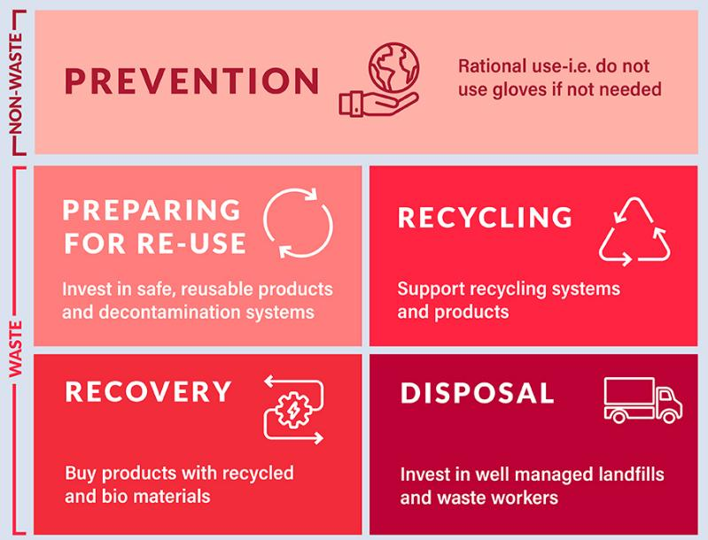
Systems investments needed with a focus on waste reduction
Change how we procure and what we procure: don’t use PPE if not needed, biobased packaging and PPE materials
Strengthen national sustainable waste standards and regulations
Increase investments in training, waste workers and expertise, recycling and non-burn waste treatment technology
Utilize reverse logistics to transport waste to better quality, centralized treatment
Segregation
Collection
Transport
Storage
Treatment
Final disposal
Minimization
Notes:
WASH in health care facilities is included in many global health strategies and standards and recognized as a fundamental element to achieving health goals. Specifically:
For quality health services-WASH in health care facilities saves costs in the health systems through reduced health care associated infections and reduced need for medication, greater staff morale and improved performance and greater uptake of health care services and satisfaction of care. WASH in HCF standards, monitoring and resources ought to be included in any national efforts on quality health services. Learn more at: https://www.who.int/publications/i/item/9789240011632
WASH in HCF is essential for IPC practices and IPC actors have a role in advocating for, monitoring and collaborating with WASH actors on using joint tools and approaches. Learn more about minimum IPC requirements here: https://www.who.int/publications/i/item/9789241516945
The standards for improving quality of maternal and newborn care identify WASH as one of 8 critical areas for improving the provision and experience of care around time of childbirth. Improving water services, toilets, showers and hand hygiene within maternity settings can significantly improve health outcomes for mother and child. The Network for Improving Quality of Care for Mothers, Newborns and Children (Quality of Care Network) works to implement these standards in 11 focus countries on dedicated quality improvement (QI) efforts and is an important platform for sharing lessons learned globally. Learn more: https://www.who.int/teams/maternal-newborn-child-adolescent-health-and-ageing/quality-of-care
Antimicrobial resistance is a growing threat and WASH in health care facilities is needed to prevent AMR infections, prevent spread of AMR in the environment (e.g. through safely managed sanitation/wastewater) and ensure safe and effective treatment of those that have antibiotic resistant infections. Including WASH in HCF plans, budgets and monitoring with national Antimicrobial Resistance plans is one important means by which to increase political buy-in and multisectoral action. Read more here:https://www.who.int/activities/supporting-countries-with-national-action-plan-implementation

Slide 8
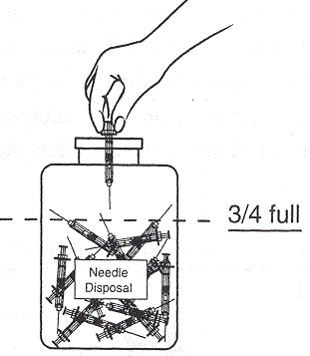
Segregation – the key to safe HCWM
Can significantly reduce the amount of waste that requires treatment
Segregate at source, where waste is generated
Don’t overfill bags / bins
Use different colors and labels for easy identification
3-bin standard system:
  General
  Infectious
  Sharps
Black container (lined)
Yellow container (lined)
Sharps box / Needle cutter
Segregation
Collection
Transport
Storage
Treatment
Final disposal
Minimization

Slide 9
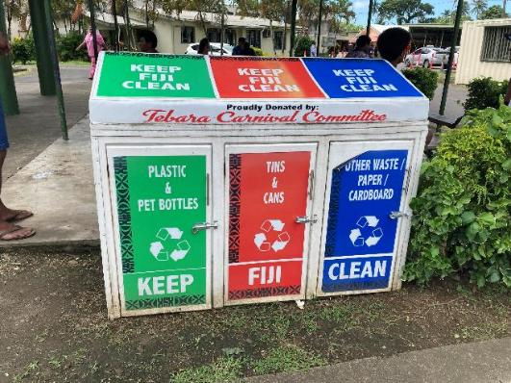
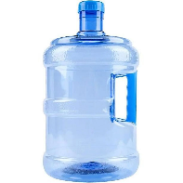
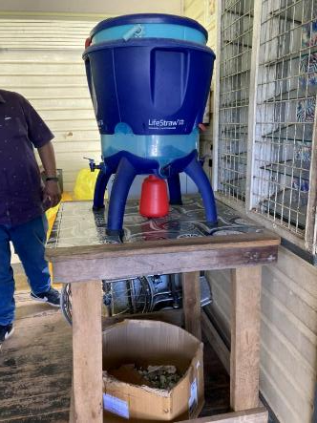
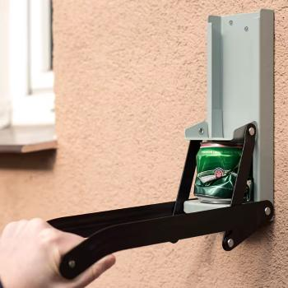
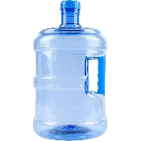
Practical solutions and technologies
Waste prevention – reduction of hazardous waste generation
  Change how and what we procure: don’t use PPE if not needed, biobased packaging and PPE materials
  Use reusable water jugs (5-10 liter)
  Purchase mercury free and PVC free products
Reduction and recycling
  Plastic bottles, cardboard / paper, cans
  Composting biodegradable waste
  Shred or compact plastic, cans
  Crush vials to reduce volume and prevent reuse
Notes:
PaPw

Slide 10
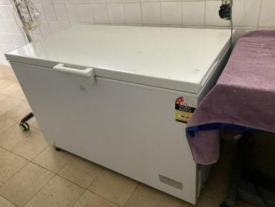
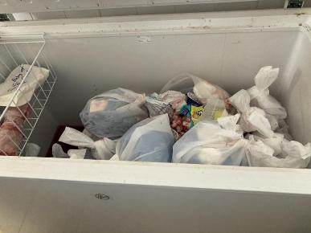
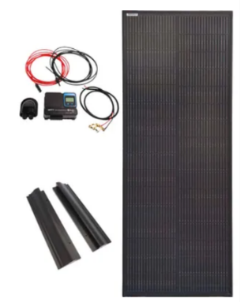
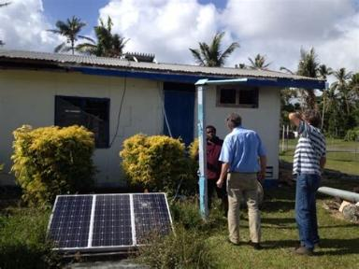
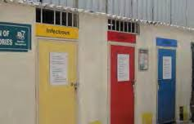
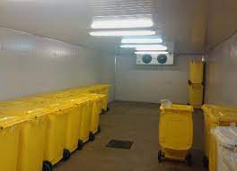
Improve safe waste storage (infectious waste)
Extend storage time by using refrigerators or freezers for infectious waste
Implement solar systems for reliable electricity (freezer, waste treatment)
Provide safe waste storage infrastructure

Slide 11
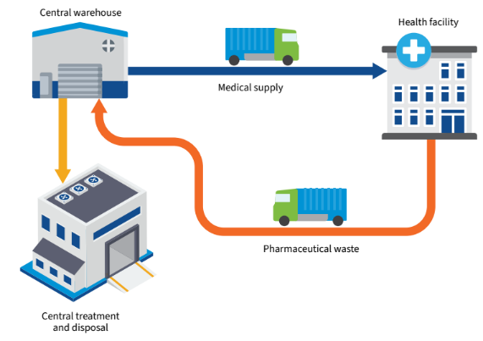

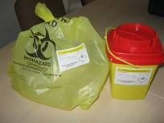
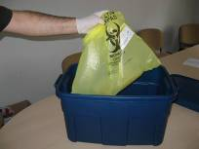
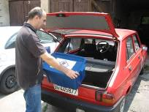
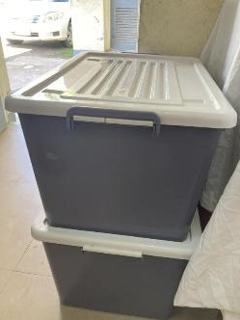
Safe external transport of waste
Establish reverse logistics where possible
Use of reusable labeled and lidded transport boxes for vehicles and boats (increase safety)
Train drivers, logistic staff
Covering of loading bay (increase safety)
1. Inner Packaging | 2. Outer Packaging | 3. Loading into vehicle

Slide 12
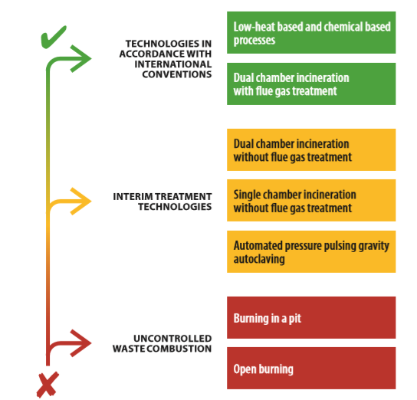
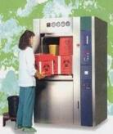
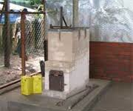
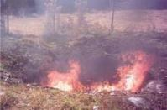
Hierarchy of waste treatment options for infectious and sharp waste
Segregation
Collection
Transport
Storage
Treatment
Final disposal
Minimization
Notes:
READ SLIDE
SAY:
Green
preferred options as these limit emissions to the environment (autoclave does not emit emissions, emissions from incineration can be cleaned by a flue gas cleaning system).
Technologies in accordance with International Conventions
Yellow
interim solutions.
Technologies used to incrementally improve practices and move towards meeting international standards
Red
considered as the last resort options
not recommended but sometimes the only feasible option for emergency or as an interim solution.
should be minimized and eliminated as soon as possible and wherever feasible.

Slide 13
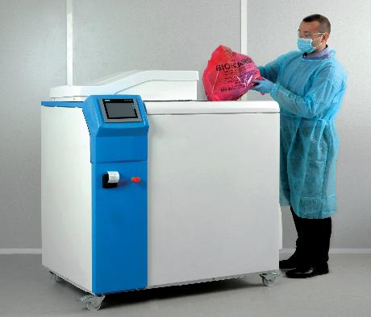
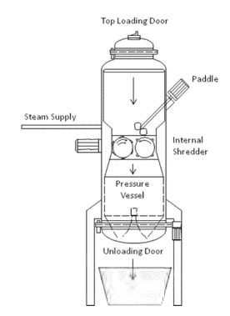
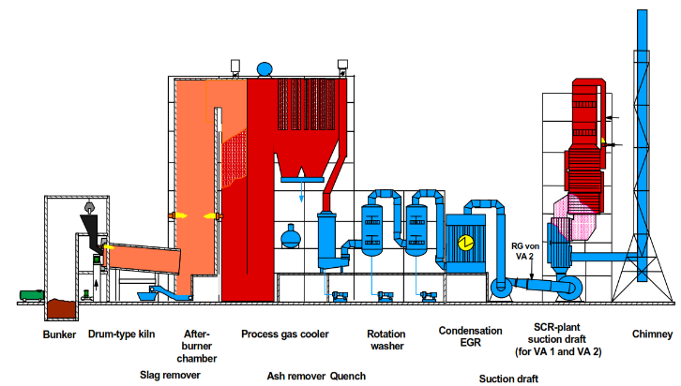
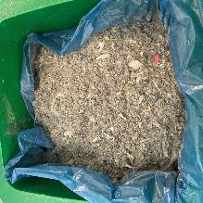
Treatment technologies
Establish centralized waste treatment centers where possible
Use alternative non-burn techs for the treatment of infectious and sharp waste (also small units available): dispose as non-hazardous general waste
Incineration: in accordance with Stockholm Convention requirements
  high temperature, 2-chamber, flue gas treatment (large centralized equipment)
Flue gas treatment system

Slide 14
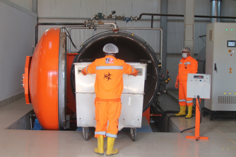
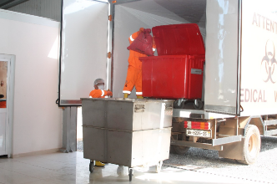
ZoomPak – Central Treatment Facility in Ghana
Central treatment facility in Greater Accra Region in Ghana (high density - 4 Mio inhabitants)
Outline of the treatment area:
  reception area
  refrigerated temporary storage
  large autoclave: 1.5 tons per cycle
  shredding system after decontamination
Collection of waste is included in the service
Investment costs: ~ 1 million USD

Slide 15
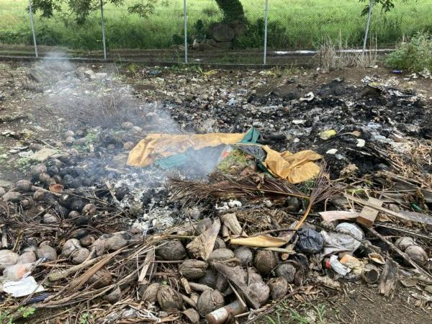
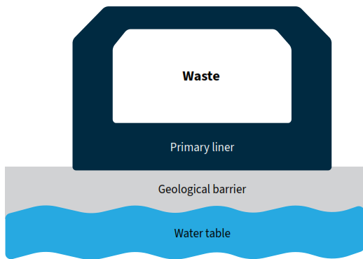
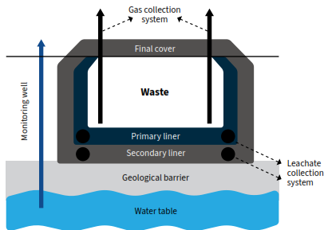
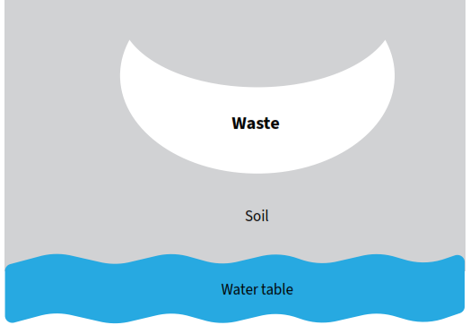
Burning and landfill
Waste burning is a significant source of dangerous carcinogens like dioxins and furans, and black carbon, that contributes to climate change human health issues
Ban open burning
and monitor compliance
Coordination with the relevant ministry to plan for safe sanitary landfills: Incremental improvement
Dumpsite
Sanitary Landfill

Slide 16
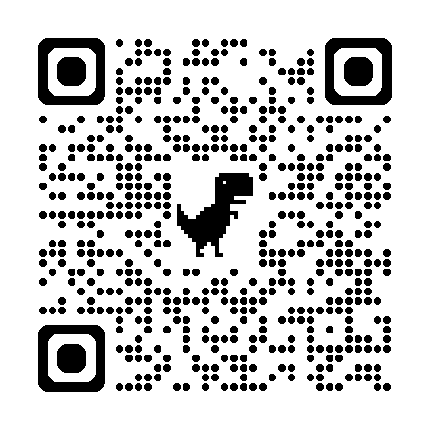
Growing concerns of pharmaceutical waste and spread of AMR - WHO best practices guidance
Focuses on pharmaceutical waste generated in health care facilities, in both non-emergency and emergency settings
Emphasis on prevention/ minimization as well as optimal and interim treatment options
16 case studies illustrate “how to” in different settings
Intro: Sources & risks, purpose, audience
Legislation
Waste prevention and minimization
Pharma waste components
Treatment & disposal options
Processes by sorting category

Slide 17
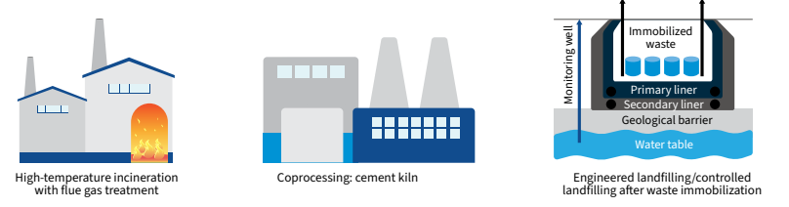
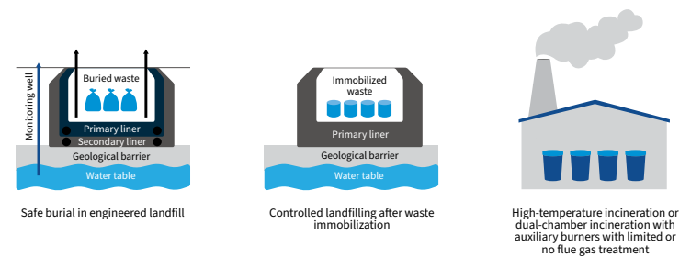
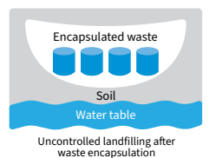

Pharmaceutical waste treatment and disposal options
Optimal options
  Interim solutions
            3. Immediate response in emergency situations

Slide 18
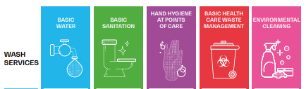
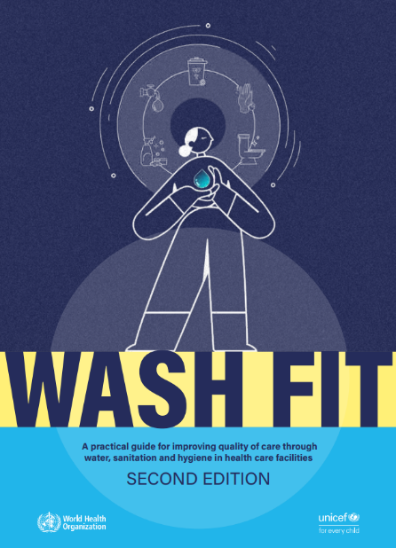
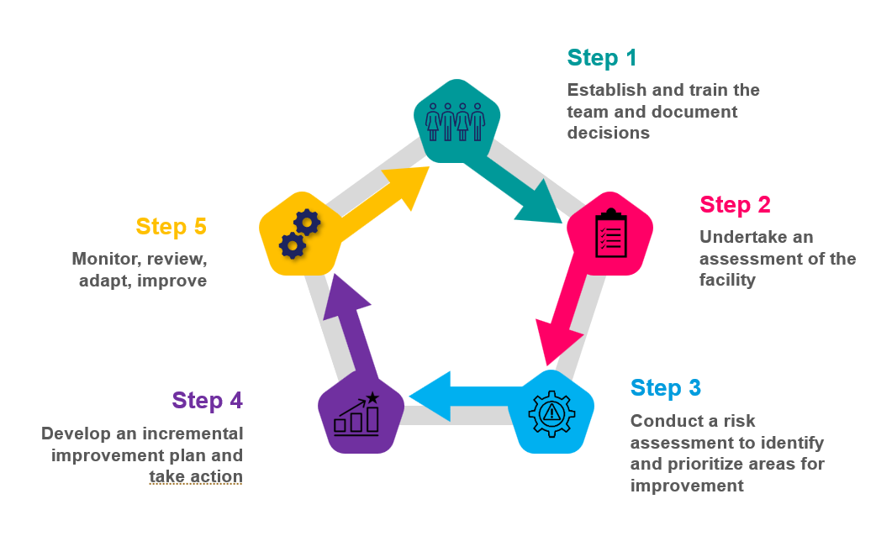
WASH FIT-an improvement framework for health care facilities
Making incremental waste improvements through WASH FIT

Slide 19
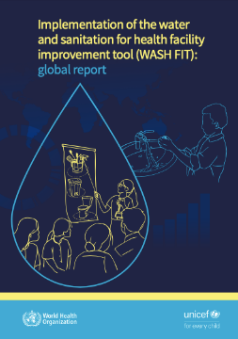


Global evaluation finds WASH FIT leads to improved waste services
Risk-based incremental improvement approach
Most effective when linked to national efforts to strengthen standards, monitoring, and health workforce
In use in over 70 countries
Training slides and factsheets available in all UN languages at: https://www.washinhcf.org/wash-fit-portal/
Nearly 90% of facilities improved waste management

Slide 20


Pilot study of WASH FIT in Ukraine
Country example: WASH FIT led to waste improvements in Ukraine
Supports improved operations and management, improved budgets and financing and improved services
Helps effectively directed resources where they will have the biggest impact
Used in over 70 countries, from all regions
Facilities received:
  3-day training
  on-site mentoring
  small funds to implement improvement plans
  monitoring support
After 6 months average WASH FIT score improved by 18 points to 83
Improvements were:
  greatest in health care waste (+30) hand hygiene (+31)
  least in sanitation (+7)
3 facilities excelled and increased their score by more than 40% compared to baseline

Slide 21


Technical resources
Documents & Tools
Videos & Courses
Websites & Social Media
WHO Safe management of wastes from health care activities (2017)
Overview of technologies for the treatment of infectious and sharp waste from health care facilities (2019)
Compendium of WHO and other UN guidance on health and environment (section on priority settings, including health care facilities (2021)
WASH FIT: A practical guide for improving quality of care through water, sanitation and hygiene in health care facilities (2022)
Global analysis of health care waste in the context of COVID-19 (2022)
Estimating the cost of achieving basic WASH and waste management services in public health-care facilities in the 46 UN designated least-developed countries (The Lancet)
Safe management of pharmaceutical waste from health care facilities (2025)
Preventing and managing small mercury spills in health care facilities: best practices (2026)
WHO Academy: https://whoacademy.org/
  Water and Sanitation for Health Facility Improvement Tool (WASH FIT) for improved quality of care
    Standard precautions: Waste management (IPC)
Training modules in health-care waste management
All-Hazard Rapid Response Teams Training Package
Occupational safety and health in public health emergencies: a manual for protecting health workers and responders
HealthWISE - Work Improvement in Health Services (ILO)
WHO WASH health care waste page
WASH in Health Care Facilities portal
WHO Infection prevention and control page
WHO occupational health page
Infographics
Sudden increases in volumes
Keeping health workers safe
Follow the waste hierarchy model
Nearly 1/3 of PPE shipped cannot be safely bagged or stored
The COVID-19 response is generating a mountain of extra waste
Monitoring and valuing WASH and waste services in health care facilities for safer, more equitable care.
Environmental cleaning in the context of Covid-19.

Slide 22








Thank you
Learn more and sign up for newsletter at WHO/UNICEF knowledge portal:
www.washinhcf.org
Latest waste data at WHO/UNICEF Joint Monitoring Programme:
www.washdata.org
WHO WASH Website:
https://www.who.int/health-topics/water-sanitation-and-hygiene-wash#tab=tab_1

Slide 23


Linking to global leadership and country actions
Countries commitments
  UN General Assembly Resolutions (2023, 2026)
  Global IPC Action Plan and Monitoring Framework (2024), WHO Global Programme of Work (2025-2028)
WHO/UNICEF regularly monitor and report on health care waste and provide technical support
  WASH and Waste services: www.washdata.org
  National policies and investments: www.washinchf.org
  Implementation (WASH FIT) >70+ countries
Leadership and community engagement
  Global Strategic Network (health, WASH, energy, climate)
  Over 40+ partners implementing and contributing
VISION: All health care facilities have safe, sustainable, and inclusive water, sanitation, hygiene, and health care waste management and reliable electricity for quality care.
Quality health care & UHC
Maternal & child health
IPC
Global Framework for Action
2025 Global Progress report
For Antimicrobial resistance

Slide 24



Use of WASH FIT to Support Safe Management of Health Care Waste in Fiji
Mr. Luke Vonotabua,
Chief Health Inspector (CHI)
Ministry of Health and Medical Services
(MoHMS), Fiji
27 May 2026

Slide 25
Presentation Overview
Fiji Health System Context
Background and Importance of Health Care Waste Management
What is WASH FIT?
How WASH FIT was implemented in Fiji
Key findings on Health Care Waste Management
Challenges identified
How WASH FIT supports improvement planning
Priority actions for Fiji
Recent progress and next steps

Slide 26
Fiji Health System context
Country Context
Population: approximately 930,000 people
Geography: Small Island Developing State (SIDS) comprising more than 330 islands
Administrative Divisions: Central, Eastern, Northern, and Western
Large rural, remote, and maritime populations create unique service delivery and waste management challenges
Fiji Health System Network
The MoHMS oversees:
3 Divisional/ Specialist Hospitals
20 Sub-divisional Hospitals
More than 80 Health Centers
99 Nursing Stations
Total: 202 health care facilities
Implications for Health Care Waste Management
All health facilities generate varying volumes and types of health care waste
Waste streams include infectious waste, sharps, pharmaceutical waste, and general waste
Remote and maritime facilities face additional challenges related to:
            Waste collection and transportation
            Storage and treatment infrastructure
            Limited workforce and maintenance support
            Supply chain constraints for PPE and waste management materials

Slide 27

Why Safe Health Care Waste Management matters
Protects patients, health workers, cleaners, waste handlers, and communities
Reduces infection risks and environmental contamination
Supports infection prevention and control (IPC) systems
Ensures compliance with national and global health standards
Strengthens climate resilience and safe service delivery in health facilities

Slide 28



Policy foundation for HCWM in Fiji
Notes:
Fiji has established a strong policy foundation for HCWM, including the Guidelines for Climate-Resilient and Environmentally Sustainable Health Care Facilities (2020) and a national Healthcare Waste Management Policy, which position HCWM as a core component of safe, resilient, and environmentally sustainable health services. However, translating these policy commitments into consistent practice across all levels of the health system remains a key challenge. In addition, Fiji also has an Environment Management Act that provides strong policy guideline for transportation of waste and final disposal or treatment of healthcare waste.

Slide 29



Policy foundation for HCWM in Fiji

Slide 30

What is WASH FIT?
WASH FIT = Water and Sanitation for Health Facility Improvement Tool
Developed by WHO and UNICEF to improve WASH and IPC services in health facilities
Supports continuous quality improvement through a risk-based approach
Covers water, sanitation, hygiene, waste management, environmental cleaning, energy, and management systems
Encourages facility-level ownership, monitoring, and action planning

Slide 31

WASH FIT Process in Fiji
National assessment conducted across 197 health care facilities
Assessment implemented in 2023 and completed in early 2024
44 staff trained by MoHMS, WHO, and UNICEF
Data collected using digital tools (KoBo Toolbox and Ona)
Facility teams included IPC nurses, medical officers, cleaners, plumbers, and environmental health staff
Findings aligned with WHO/UNICEF JMP service ladders

Slide 32

Health Care Waste Management findings
62% of facilities achieved the basic service level for health care waste management
Around one-third of facilities lacked proper waste segregation systems
Nearly half of facilities did not have secure waste storage areas
Smaller and remote facilities faced greater infrastructure and staffing challenges
Hospitals and health centres generally show stronger performance, while nursing stations face gaps in meeting basic service requirements.
Proportion of HCFs Achieving Basic Health Care Waste Management Service Level by Sub-Division
Health Care Waste Management JMP Service Level
Notes:
Health care waste service levels vary considerably across facility types. Hospitals and health centres generally show stronger performance, while nursing stations face gaps in meeting basic service requirements. Common deficiencies include improper segregation of waste at generation points and limited capacity to ensure safe transfer to licensed disposal facilities. These weaknesses increase occupational and environmental risks and reflect broader infrastructure and systems challenges. Addressing these gaps will require improvements in waste handling protocols, facility-level oversight, and better linkages with waste management services.

Slide 33
How WASH FIT supports safe waste management
Helps facilities identify waste management risks and service gaps
Provides structured indicators for segregation, storage, transport, and disposal
Supports development of facility improvement plans
Strengthens monitoring and accountability through routine assessments
Promotes multidisciplinary teamwork and staff engagement
Supports prioritisation of resources and investments

Slide 34
Key challenges identified
Limited funding and access to maintenance support
Inconsistent availability of waste bins, liners, and PPE
Gaps in staff training and supervision
Weak monitoring systems in some facilities
Infrastructure limitations in rural and maritime facilities
Need for stronger coordination between facility and divisional levels
Treatment systems are often absent, non-functional, or inadequate for the volume and type of waste produced.

Slide 35

Summary of Key Healthcare Waste Management Indicators by Sub-Division: Segregation
Notes:
Segregation: While the majority of facilities report having appropriate bins at all waste generation points, approximately one in three still lack full compliance with segregation protocols. This poses avoidable risks to patients, staff, and waste handlers.

Slide 36

Summary of Key Healthcare Waste Management Indicators by Sub-Division: Waste Storage
Notes:
Waste storage practices are even more limited. Fewer than 30 of 199 facilities have secure, dedicated storage areas that meet basic requirements such as fencing, separation of waste types, and adequate capacity. Nearly half of all facilities have no designated waste storage space at all. These gaps represent a serious failure in managing infectious and hazardous waste, with implications for both occupational safety and environmental health.

Slide 37

Summary of Key Healthcare Waste Management Indicators by Sub-Division: Waste Collection containers

Slide 38
Priority Actions for Fiji
Strengthen implementation of national WASH and IPC standards
Improve waste segregation and secure storage systems
Expand training for environmental health and facility staff
Strengthen routine monitoring using WASH FIT
Improve access to supplies, equipment, and maintenance support
Increase investment in resilient health care waste treatment systems
Finalise and operationalise national SOPs for WASH and HCWM in health care facilities
Align facility improvements with WHO/UNICEF WASH Minimum Standards
Notes:
Insights From WASH FIT Survey Comments: Gaps in training and oversight. In many facilities, waste management tasks were handled by nurses without formal training, and few had written procedures or active waste management plans. Audits were infrequent and not always followed by corrective action. Enumerators frequently recommended fenced storage, functioning incinerators, and clear guidance, particularly for facilities without access to municipal services.

Slide 39



Recent Progress and Next Steps
Following the WASH FIT assessment, a national HCWM Training of Trainers (ToT) workshop and field assessment were conducted to strengthen facility-level capacity on safe and environmentally sound health care waste management.
The ToT built the capacity of divisional and sub-divisional health officers, IPC officers, and facility staff on HCWM principles and practices and supported them in conducting HCWM assessments and strengthening routine monitoring and improvement planning.
Field visits across all divisions helped identify operational, policy, infrastructure, and workforce gaps across the full waste management chain.
Fiji is also developing a national Standard Operating Procedure (SOP) for WASH in health care facilities, which will include a dedicated section on health care waste management.
The recently launched WHO and UNICEF WASH Minimum Standards for Health Care Facilities will further support national efforts to strengthen safe, climate-resilient, and quality WASH and HCWM services.

Slide 40
Conclusion
WASH FIT provided Fiji with a practical framework for improving health care waste management
The assessment identified both progress and critical gaps
Safe waste management is essential for quality health care and infection prevention
Ongoing monitoring, investment, and capacity building are needed to sustain improvements
Strong collaboration across all levels of the health system will be critical

Slide 41
THANK YOU
Presenter: Mr. Luke Vonotabua, CHI, MoHMS, Fiji
Email: luke.vonotabua@health.gov.fj

Slide 42
Discussion

Slide 43





Preview
Advanced health care
waste management, including
considerations for treatment,
mercury and pharmaceutical waste
Notes:
Today I’m giving a quick preview of a new WHO/UNICEF course launching next week on advanced health care waste management. The course is designed to help health facilities and partners manage health care waste safely and sustainably across the full pathway, from classification and segregation through treatment and final disposal. It is intended for health facility staff and managers, health care waste workers, health planners, environmental health professionals, policymakers and technical partners involved in strengthening safe and sustainable waste systems. It is particularly relevant for WASH FIT because waste management is one of the practical areas where facility teams can identify risks and make measurable improvements.

Slide 44


Why health care waste management matters
Safe health care waste management helps protect:
Patients
Health workers
Waste handlers
Communities
The environment
Poor practices can increase exposure to infectious hazards, toxic substances and harmful emissions.
Credit: UNICEF
Notes:
Health facilities generate waste every day. If that waste is safely segregated, handled, treated and disposed of, it protects people. If it is poorly managed, it can expose patients, staff, waste handlers and surrounding communities to infection risks, toxic chemicals and pollution. The course frames health care waste management as part of quality care, infection prevention and control, environmental protection, and resilient health systems.

Slide 45
Module
Module
Module 1
Module2
Module 3
Overview of safe and sustainable HCW processes
Best Available Techniques for infectious and sharps waste
Planning of waste treatment technologies
Course
overview
Module
Module
Module
Module 4
Module 5
Module 6
Demonstration of non-incineration technology and capacity exercise
Deep dive – Mercury waste
Deep dive – Pharmaceutical waste
Notes:
The course is structured around six modules. It begins with the overall system: what waste is generated, how it should be classified, and how the end-to-end pathway should work. It then moves into treatment options for infectious and sharps waste, including non-burn technologies and high-temperature incineration with proper controls. Module 3 focuses on planning and procurement. Module 4 introduces calculation of waste generation and treatment capacity. The final two modules are deep dives into mercury and pharmaceutical waste, which require additional safeguards.”

Slide 46

Practical tools for facility decisions
The course helps users:
Estimate waste generation
Size treatment capacity
Compare treatment options
Plan infrastructure and utilities
Strengthen procurement and contracts
Prepare for specific waste streams and emergencies
Notes:
One of the strengths of the course is that it moves beyond general awareness and into practical decision-making. Module 4, for example, helps facilities estimate infectious and sharps waste generation and align treatment capacity with actual facility needs. This is useful for routine planning, but also for outbreaks, emergencies or service expansion, when waste volumes may increase. This is exactly the kind of practical planning tool that can support WASH FIT improvement cycles.”

Slide 47
A companion resource for WASH FIT improvement planning
Use the course to support:
Facility assessments
Waste management improvement plans
Training and refresher sessions
Procurement and technology decisions
Mercury phase-out and spill preparedness
Pharmaceutical waste systems
Notes:
The course is designed for health facility staff and managers, waste workers, planners, environmental health professionals, policymakers and technical partners. For the mini-clinic audience, the key message is simple: this is not just a course to complete individually. It can also be used as a practical companion resource for WASH FIT teams, especially when developing improvement plans, training staff, reviewing waste flows, or preparing for specific risks such as mercury spills or pharmaceutical waste disposal. I may show a short section from the mercury spill film, because it demonstrates the practical, step-by-step style of the course.

Slide 48


A growing WASH learning ecosystem
WHO Academy self-paced WASH & related offerings on:
WASH FIT (English, Ukrainian and soon French), Env. cleaning
Infection prevention and control
Environmental cleaning and waste management
Water safety planning
Safely managed sanitation and SMOSS monitoring
GEDSI in WASH in health care facilities
AMR, NTDs and climate-resilient WASH
Notes:
This course should be seen as part of a broader WHO Academy WASH learning portfolio. The WASH courses are designed as a stackable learning ecosystem, helping countries move from WHO guidance to practical implementation, from national policy to the point of care. For WASH FIT teams, this means the health care waste course can sit alongside the WASH FIT course itself, GEDSI in health care facilities, IPC-related courses, environmental cleaning, water safety planning, sanitation and SMOSS monitoring. The value is not only individual learning, but also using these courses as pre-work for workshops, onboarding for staff and partners, refreshers for facility teams, and support for supervision and quality-improvement cycles

Slide 49




Closing
WASH FIT Guide
Catch up on meet up 1:

